Slide 1
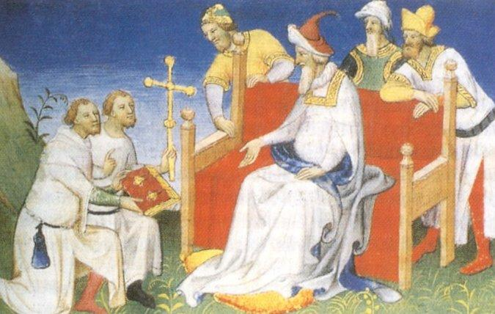
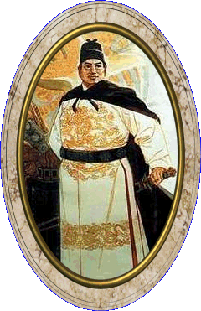
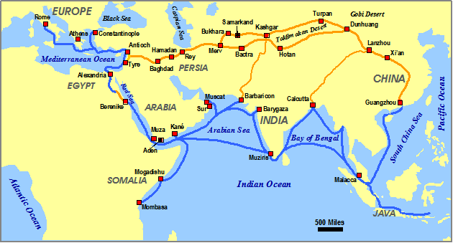
AP World Review Post-Classical Civilizations
Priscilla Zenn
Allen Park High School
*Source: AP World History
An Essential Coursebook
by Ethel Wood

Slide 2
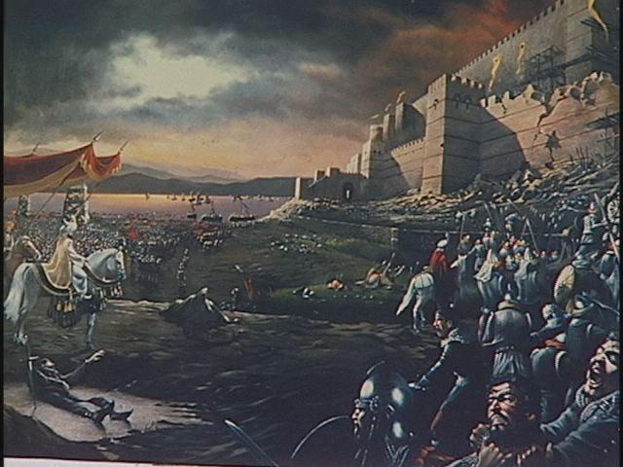
Post-Classical Era 600 CE-1450 CE
Map of the world had changed; large empire split into smaller, quarrelsome political units

Slide 3
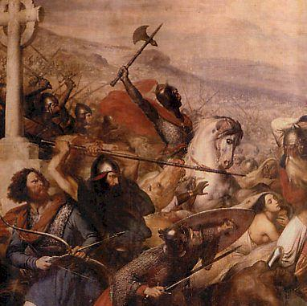
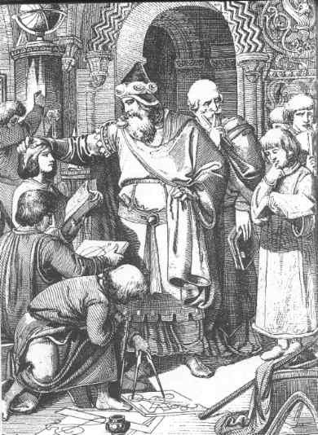
Western Roman Empire
Germanic tribes settled in the area of the Western Roman Empire

Slide 4
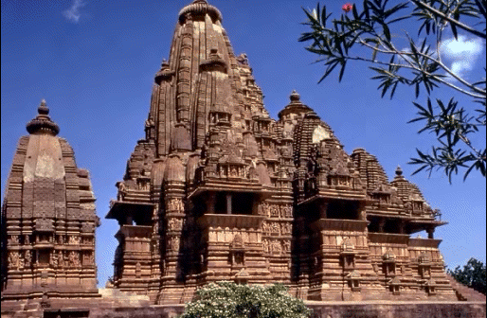
Indian Sub-Continent
The Indian sub-continent returned to its regional political factionalisms but Hinduism gave structure to society

Slide 5
China
China on the verge of political centralization after the fall of the Han and resulting 400 years of political chaos due to the unifying influences of Confucianism and Daoism

Slide 6
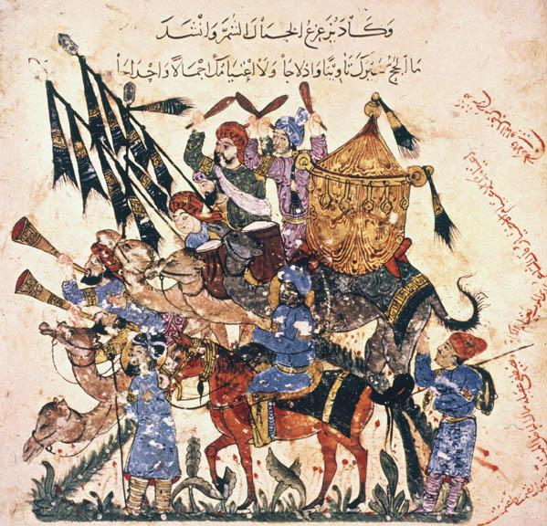
Overall
The post classical era saw the emergence of:
important new civilizations
the revival and expansion of some old civilizations
the peak of influence of nomadic groups
the importance of belief systems as unifying forces
the increasing interconnections among the world’s people through trade networks

Slide 7
Keep in mind what did NOT happen!
Eastern and Western hemispheres were not joined.
The Americans were developing in isolation from Asia, Europe, and Africa. Australia and Polynesia were also developing on their own.
Technology expanded but innovations were not numerous.
Expansion was more characteristic than innovation. Previous technologies diffused far beyond the region of innovation
camel saddles, stirrups, silk-making techniques, steel plows

Slide 8
Keep in mind what did NOT happen!(cont)
No political form became dominant
Empires in this era were smaller and many other organizations emerged (previous era empire was the dominant political form)
kingdoms, caliphates, khanates
Environmental changes were not as great as in other eras
More areas became agricultural, but no massive transformation such as during the classical era
*Roman era saw the soil become depleted of nutrients

Slide 9
Keep in mind what did NOT happen! (cont)
Most societies remained patriarchies with clear social distinctions
Few changes in gender relations but in some areas inequality between the sexes grew
Slavery remained characteristic of most social systems
Status and wealth was still based primarily on land ownership
Land ownership disputes remained problematic

Slide 10
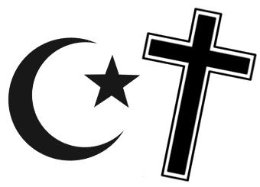
The BIG Picture
Belief systems were unifying forces
Christianity, Buddhism, Islam (missionary religions)
Islam spread from its origins
Buddhism important in China and spread to Korea, Japan, and SE Asia.
Christianity important in most of Europe.

Slide 11
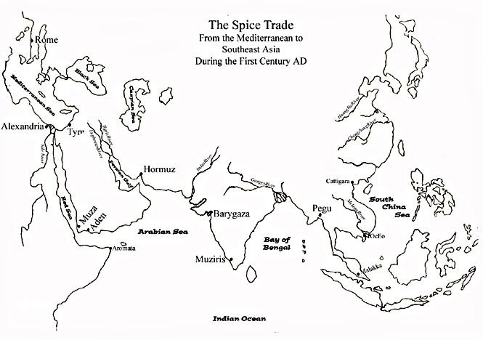
The BIG Picture (cont)
Civilizations spread to many parts of the globe
Including Sub-Saharan Africa, N and W Europe, Japan, SE Asia, and the Americas. Nomadic groups influence at its peak.
Feudal Europe
Mongols
Dar-al Islam
Tang and
Song China

Slide 12
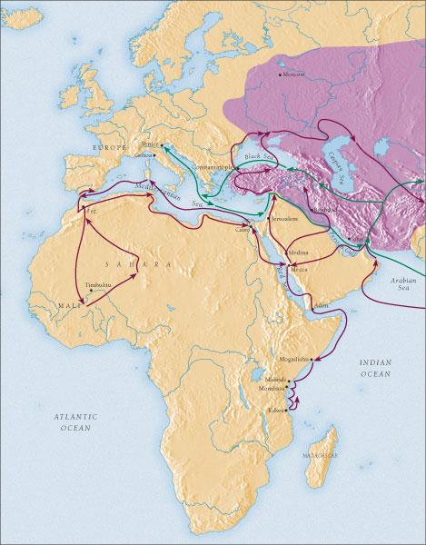
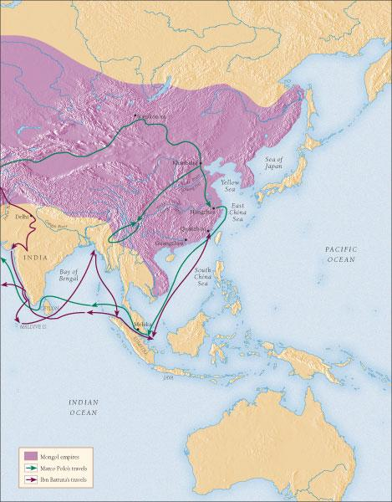
The BIG Picture (cont)
Trade and communications networks increased the interdependence of numerous societies
Technologies spread and more cultural exchanges took place. Land and water routes became more complex; spread of disease also accelerated.

Slide 13
Keep in Mind:
The influence of the classical civilizations continued
Political lines reconfigured and governing styles changed but the Middle East, China, India, and Eastern Roman Empire remained powerful with the greatest cities of the world in these areas.
As we approach the end of this era the world was already beginning to change as Europeans prepared to set sail on the Atlantic.

Slide 14
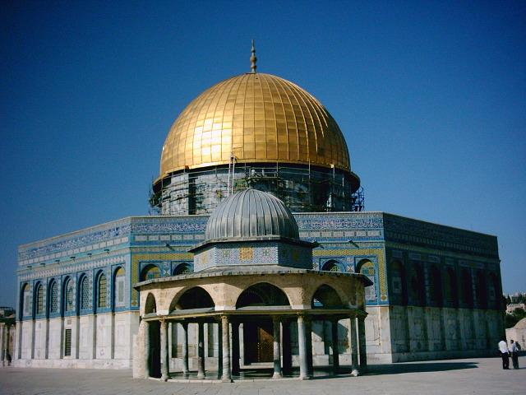
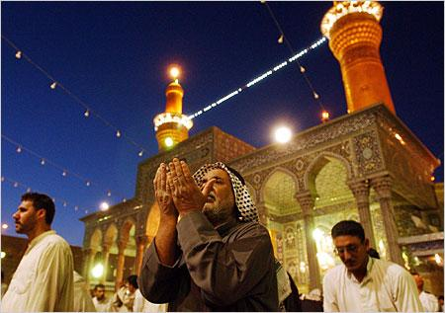
Islamic World
A vast region shaped by religious conquest that illustrates the importance of belief systems as unifying forces during this period

Slide 15
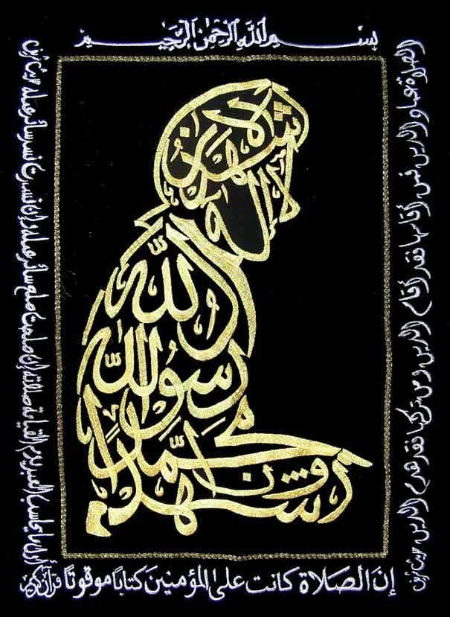
Islam
Spread quickly and deliberately by adherents
Principles appealed to people of many cultures
Religion was beginning to play an important role as cultural and economic force in Eurasia at this time (remember, governments fragmented and religion and philosophy connected people).

Slide 16
The Origins of Islam
Desert region
Bedouins (kinship groups)
Conflicts over grazing lands/water
Mecca
Shrines – religious pilgrims
Ka’ba held Black Stone and idols
Bedouin religion a blend of animism and polytheism

Slide 17
Muhammad’s Visions
Merchants came into contact with other clans and people of different faiths
Visions: visited by Angel Gabriel as messenger from Allah
Received revelations that became tenets of Islamic faith
Gained a following as he shared revelations; set off rivalries
Flight to Medina known as hijrah and is the founding date of the new faith

Slide 18
Growth of Islam
Muhammad returns to Mecca in triumph
Destroys idols, keeps Black Stone to symbolize acceptance of Allah as one god
Umma – Muslim community
Clans united under banner of Islam

Slide 19
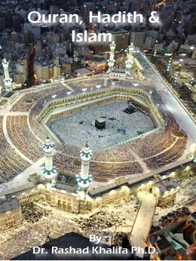
Islamic Beliefs
Qu’ran
Revelations believed to be sacred words of Allah
Hadith
Collection of sayings of Muhammad
Shari’a law based on Qu’ran and Hadith
Seal of the Prophets
Muhammad as the last prophet sent by God
Abraham, Jesus

Slide 20
Five Pillars of Islam
Confession (declaration) of faith
Prayer (5x per day facing Mecca)
Fasting (Ramadan)
Alms (give to the needy)
Hajj – pilgrimage to Mecca to worship Allah at the Ka’ba.
Established customs:
don’t eat pork or drink alcoholic beverages
Men could have up to four wives.
Marriage with non-Muslims was forbidden.
Equality of all believers.
Worship in a mosque.

Slide 21
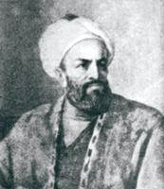
Muhammad’s Successors
Ali (cousin and son-in-law of Muhammad) passed over for Abu Bakr to be caliph
raided large areas revealing the weaknesses of the Byzantine and Sassanid empires
Islamic lands from NW Africa and Spain to Indus River
Arabs passionate about new faith
Jihad – struggle and also used to describe warfare

Slide 22
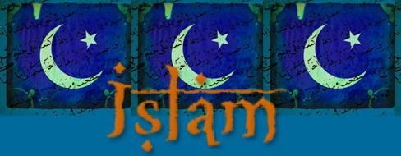
Muhammad’s Successors (continued)
Succession issues led to split
Shi’ites – caliph to be selected according to hereditary lines
Sunni – pious Muslim

Slide 23
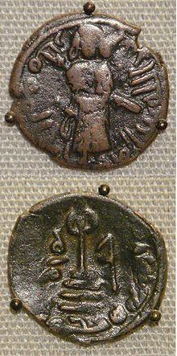
Umayyad Dynasty
Election of Muawiya led to split between Sunni and Shi’ite sects
Sunni
Capital at Damascus
Caliph powerful and imperial
Continued expand under this dynasty; from Afghanistan to Spain
Charles Martel; battle of Tours

Slide 24
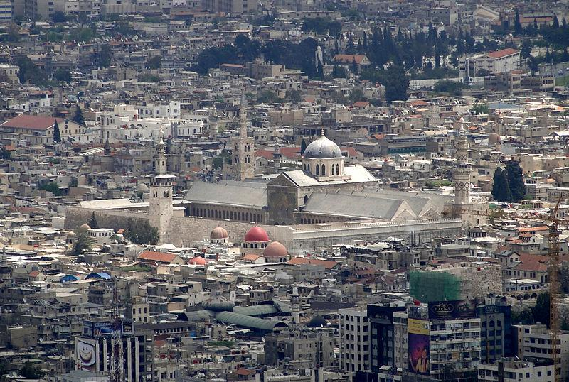
Umayyad Dynasty (cont.)
Government:
Bureaucracy
Muslims taxed for charity, non-Muslims paid taxes to support govt
Some intermarrying and conversion (few financial benefits at this time)
Converts not considered part of umma but mawali
People of the Book treated better than other beliefs but had to pay same taxes
Exclusion of non-Arabs in government led to problems and chaos as empire grew and demands grew for social
and religious equality
for Arab Muslims.
Mawali rebellion
Abbasid clan took control

Slide 25
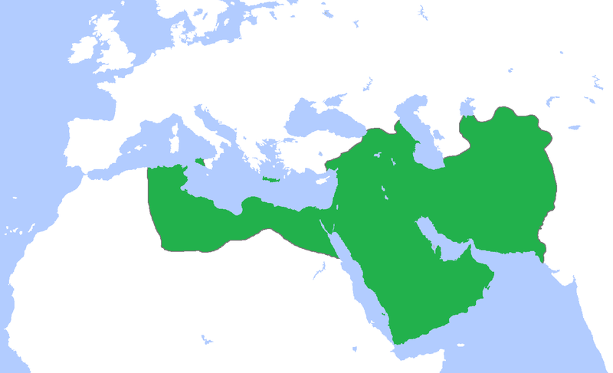
Abbasid Dynasty
Claimed descent from Muhammad’s uncle; more acceptable to Shi’ites
Changed policies opening religion to all on equal basis
Helped est. Islam as a universalizing religion
Cosmopolitan mix of cultures emerged
Golden Age of Islam
Problems with governing vast area

Slide 26
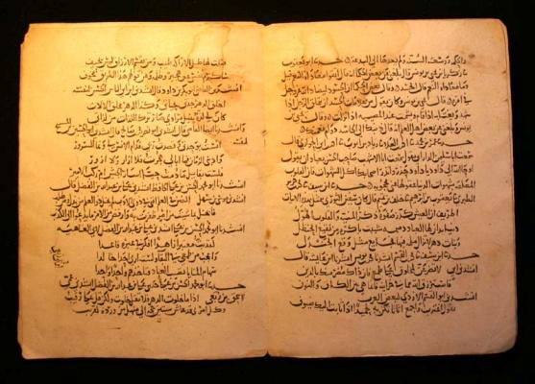
Abbasid Dynasty (cont.)
Muslim shari’a took shape
Ulama interpreted Qur’an and Hadith
Govt in Baghdad under a vizier
Provinces governed by emir
Military commanders had power
As army grew difficult for caliph to control commanders
Ulama undermined caliphs powers due to control of shari’a.

Slide 27
Golden Age of Islam
Based on agriculture
Organized system of trade led to new crops and techniques
Increase in food supply to support growth of cities
Cities were also govt and religious centers
Dhows w/lateen sails traded across seas
Caliphs had lavish lifestyles
Merchants grew wealthy from trade
Elaborate mosques and buildings
Domestic servants
Slaves (most Zanj – non-Muslim east Africans)
Economic Activities
Social Distinctions

Slide 28
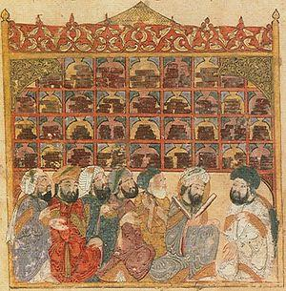
Golden Age of Islam (cont.)
Arabic language was unifying force
Promoted partly due to Qur’an
Paper from China encouraged production of books
Poetry
Universities – madrasas (preserved writings of ancient Greeks and Indians)

Slide 29
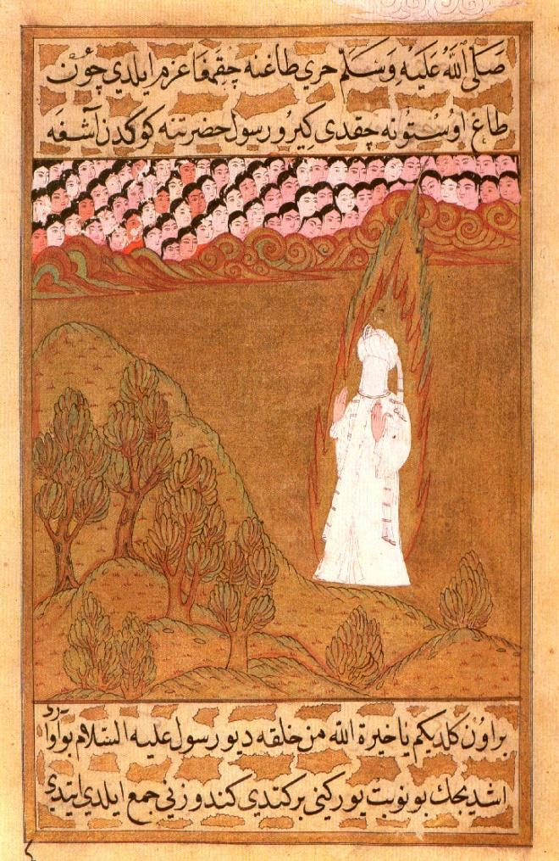
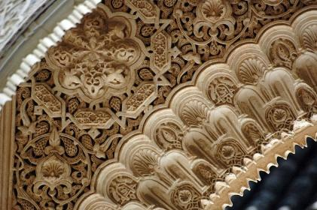
Golden Age of Islam (cont.)
Muslim art; forbade lifelike representation of human figures, including Muhammad
*Persian art depicts Muhammad w/veil
Designs of garlands, plants, and geometric figures
Calligraphy
Mosques w/minarets

Slide 30
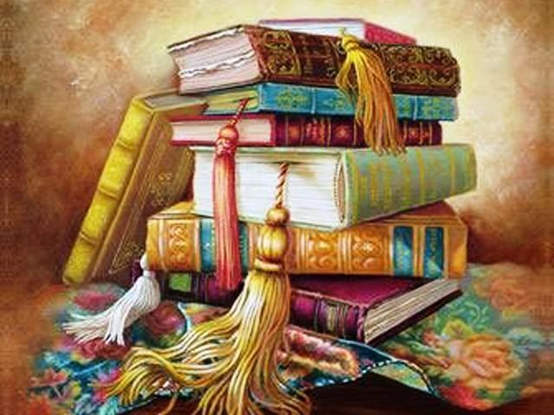
Golden Age of Islam (cont.)
Arabic numerals (from India)
Marker event – calculate large sums
Algebra
Optical Science
Pharmacology
Anatomy
Maps and geographical information

Slide 31
Decline and Fall of the Abbasid Caliphate
Hostility increased between Sunni/Shi’ites
Difficult to hold diverse empire together from one central location
Slave revolts and peasant uprisings
Incompetent caliphs
Abbasids hired Seljuk Turks as soldiers; gained power
Seljuk leader Tughril took over Baghdad; caliph is figurehead
Mongols seized throne in 1258
The Mongol IL-Khan Empire
Mongols seized throne

Slide 32
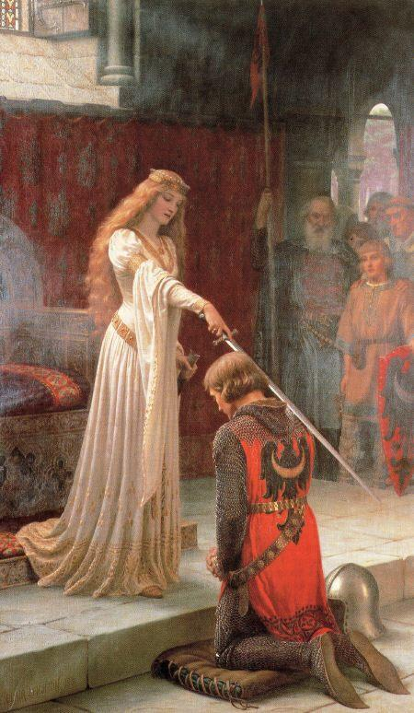
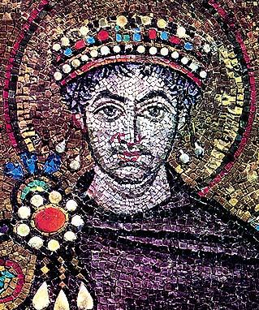
Christian Societies in Europe and the Middle EAst
Follows the changes in Europe after the fall of the Western Roman Empire, including the rise of important branches of Christianity in the area

Slide 33
After the fall of the Western Roman Empire…..
Christianity came to dominate many of the areas formerly controlled by the Roman Empire but did not unite the lands
Similar to Islam dominating lands controlled by caliphates except Islam united its lands
Patchwork of tribal kingdoms emerged in Western Europe
Byzantine Empire in the lands around eastern Mediterranean
By the end of the era, the Byzantine Empire on the verge of collapse and Western Europe had laid the foundation for the central place it would play on the world stage

Slide 34
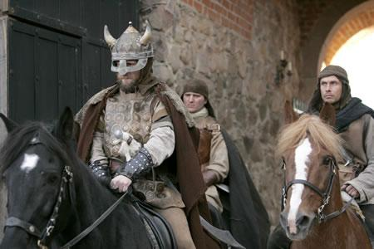
Western Europe: After the Fall of Rome
Middle Ages or medieval times
Between the fall of Roman Empire and the European Renaissance
Dark Ages?
Divide into the
Early Middle Ages
Germanic tribes.
Nomadic peoples
Subsistence farmers
Chieftains
Most people illiterate
The High Middle Ages
Signs of recovery
Growth of towns
Trade w/Eastern Hemisphere established
Emergence of middle class
Renaissance begins at the end of the era

Slide 35
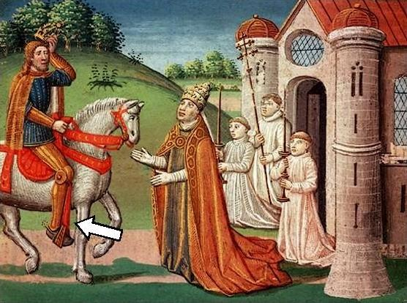
The Early Middle Ages
Collapse of political, social, and military order left Europe in chaos
Continuing invasions and conflicts
The Church provided cultural unity and enabled the area to regain some control

Slide 36
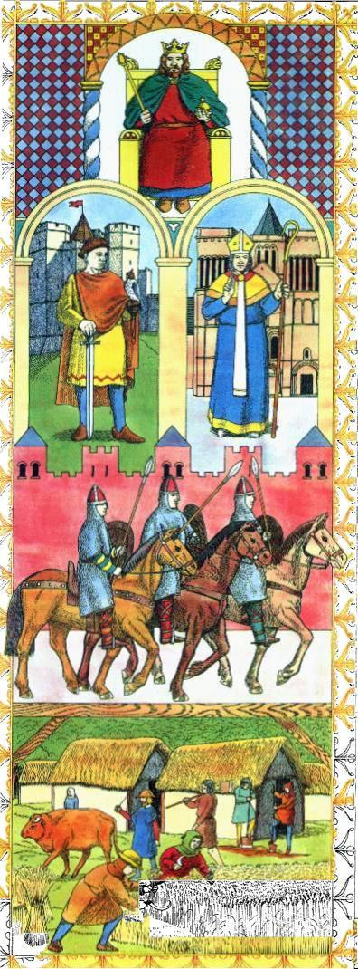
The Early Middle Ages: Political Development
Germanic Tribes; borders changed with fortunes of war
Roman governors replaced with tribal chieftains
Roman concept of rule of law replaced with informal governments based on family ties and loyalty
Warriors bound to chiefs w/oaths of loyalty
People settled on manors, feudalism and manorialism developed
Complex system with mutual obligations

Slide 37
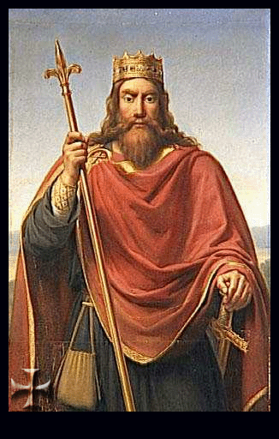
The Early Middle Ages: Political Development (cont.)
Franks managed to organize Germanic kingdoms under their kings and looked as if they might unite Western Europe under one king
Clovis: converted to Christianity
Charles Martel (Charles the Hammer) Carolingians takes control

Slide 38
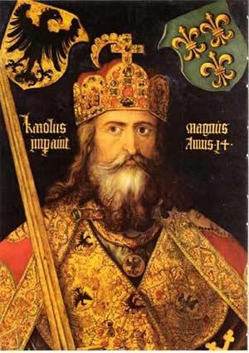
Charlemagne
Grandson of Charles Martel
temporarily unified most of western Europe
People needed protection from Vikings
Administrative system divided into counties governed by a count
Missi dominici were the eyes and ears of the king
Charlemagne moved around the empire
Pope crowned Charlemagne emperor; implying heir to Roman throne
Showed superiority of church over political leaders
After his death, the empire was divided: Treaty of Verdun

Slide 39
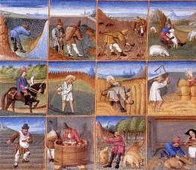
The Early Middle Ages: Economic Development
Manorialism defined both economic and political obligations between lords and peasant laborers
Serfs tied to the land; received protection, justice, and the right to graze animals. In return, they were obliged to give a portion of their products to the lord.
Trade based on barter
New ideas like the iron plow and three field system helped the serfs produce more goods

Slide 40
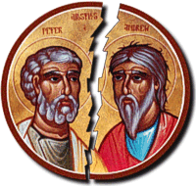
Political and Religious Power of the Roman Catholic Church
Constantine moved capital to Constantinople
Split in political authority led to split in religious authority
Popes
Patriarchs
Missionaries traveled in Western Europe
Bishops directed churches in urban areas
Church supported monasteries in rural areas
The Benedictine Rule
Monasteries played important role in providing stability during Dark Ages
Protection, schools, libraries, copied books which saved part of the intellectual heritage of the classical civilization

Slide 41
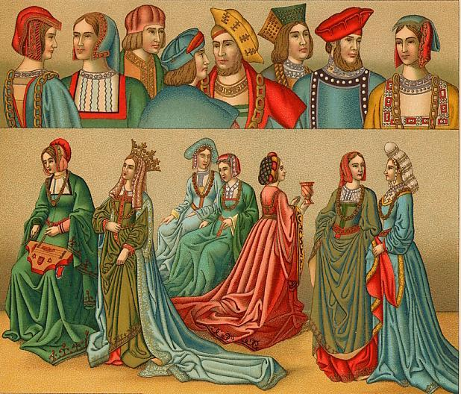
The Revival of Civilization: The High Middle Ages
Changes about 1000 CE
Innovations from eastern Europe and Asia make the difference
Moldboard plow
Three field system
Horse collar
Stirrups
Better agricultural methods promoted by monasteries
Viking raids became less serious as regional governments grew stronger
Population increased with agricultural production
Created demand for more trade/towns grew
As local economies grew, political and cultural changes occurred

Slide 42
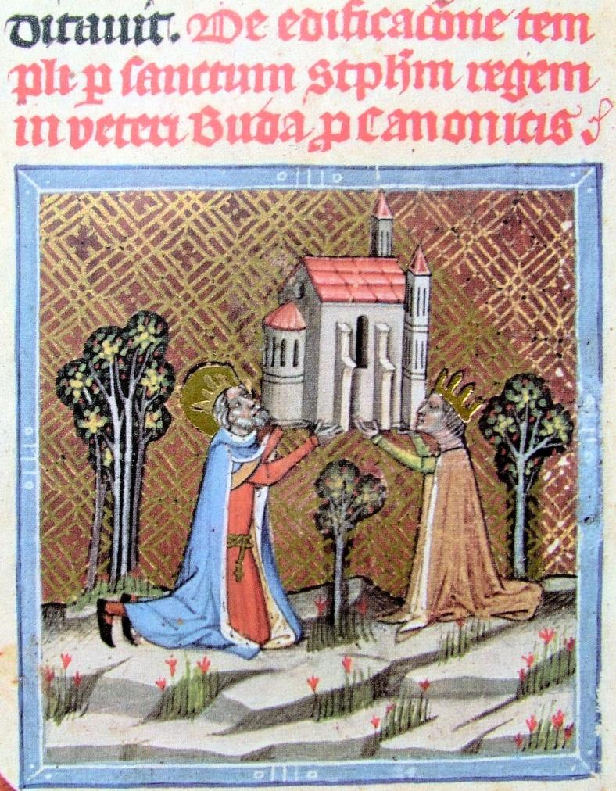
Political Developments in the Age of Faith
Feudalism discouraged growth of strong central governments
Political Power of the Church countered power of the kings
Canon law filled the void of political authority in early days
Excommunication and interdict
Friction between popes and kings grew
Nobles resisted growth of strong, central governments since they enjoyed the independence that came with feudalism and manorialism

Slide 43
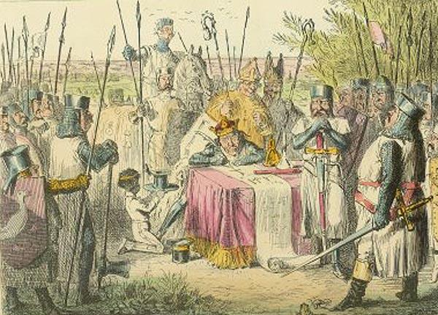
Political Developments (cont.)
Holy Roman Empire (German princes) and Eastern Europe remained feudalistic
England, Spain, France grew into centralized governments but faced many challenges
England
Magna Carta/limited government
Parliament gave people a voice in policy making
These ideas to the growth of modern democracies
Stronger monarchs gathered large armies
William of Normandy (the Conqueror)
The Hundred Years War

Slide 44
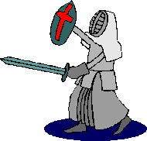
The Impact of the Crusades
Western European states expanding by 11th century
Population increases
Missionary zeal of Christians
Crusades
Request from Byzantine emperor Alexius I
Urban II calls upon knights
Remission of sins, place in Heaven, god wills it
Series of attacks that lasted for two centuries
First crusade won Jerusalem from Turkish armies
Saladin took it back in 12th century
Venice turned Fourth Crusade into attack on commercial rivals in Constantinople
Ultimately the Crusaders failed to accomplish their goals

Slide 45
The Impact of the Crusades (cont.)
Crusades laid the foundation for the emergence of European countries in the next era
Put them into direct contact with oldest areas of world civilizations
As Crusaders returned they brought back silks, porcelains, carpets, perfumes, spices, and preservatives
Europeans would not be content to remain in isolated, drafty castles; a whole new world awaited them

Slide 46
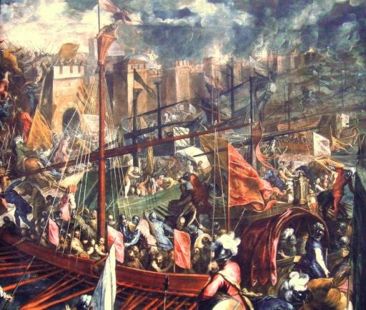
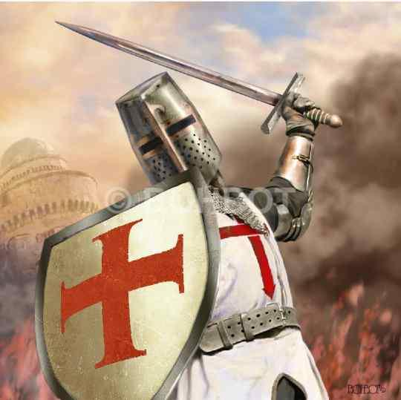
Economic Developments
Genoa and Venice benefitted from the Crusades
Carried knights and goods to and from the Holy Land; grew wealthy
Brought ideas about banking to the West
Merchants invested in trading ships
Internal trade grew
Hanseatic League (north) formed to facilitate trade
Kings sold charters/feudal ties severed
Kings received revenue from towns and built armies gaining power over aristocrats
Guilds formed
Merchant class develops
Social class structure more complex; serfs became craftsmen, etc

Slide 47
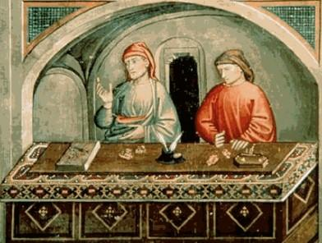
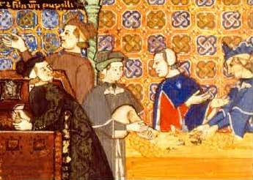
Economic Developments (cont.)
Growth of trade and banking formed the basis of western capitalism
Church against usury (charging interest); bankers were Jews
Church eventually eased its policies and became landholder and money lender
European Christians discriminated against Jews who lived in segregated communities (ghettos)
Limited there occupations
In 13th C English and French kings seized property
Pogroms drove Jews to eastern Europe

Slide 48
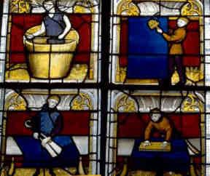
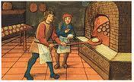
Economic Developments (cont.)
As life became more complex women faced more restrictions
In early Germanic societies women had considerable freedoms and gained respect. Many joined monastic life
As cities grew, women were excluded from guilds and their role in commerce decreased.
Women seen as subservient and were encouraged to be docile and obedient.

Slide 49
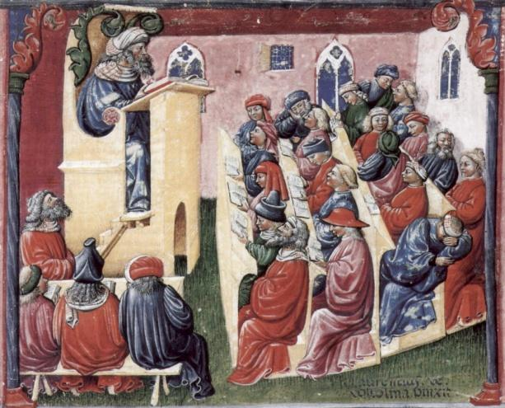
Culture and Arts
As wealth grew rise in specialized
occupations
Charlemagne brought teachers to his
court and opened a school for clergy
and officials (Carolingian Renaissance)
After the 1st Crusade universities established in Italy
Others follow; most established for clergy
Combination of Christian learning and the classics which had been preserved in the Middle East
Thomas Aquinas, Albertus Magnus, and Peter Abelard tried to reconcile values of Christianity with reason (scholasticism - Aquinas)

Slide 50
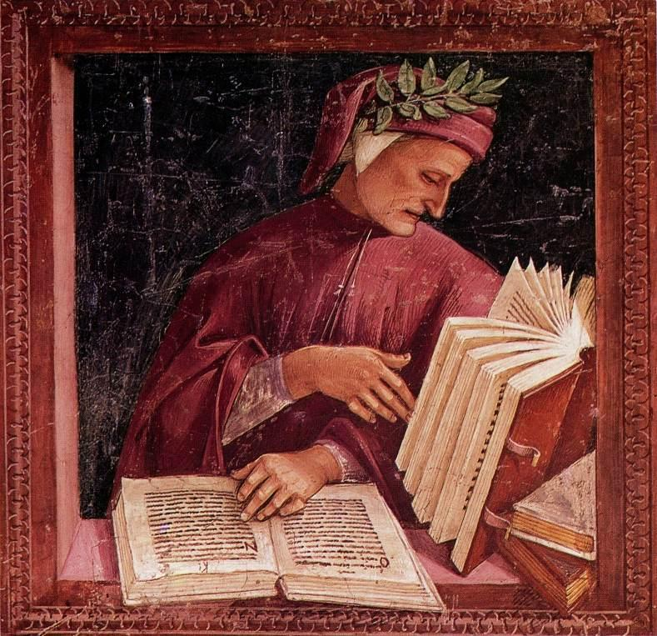
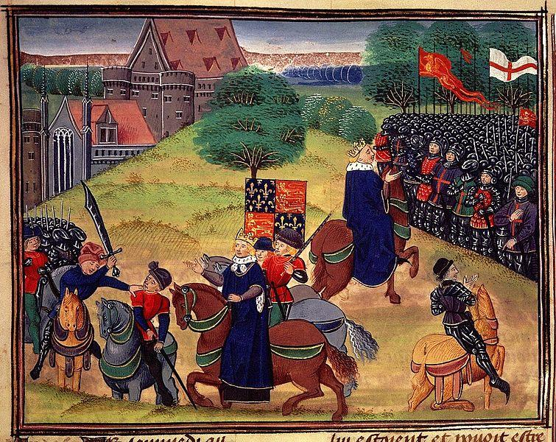
Culture and Arts (cont.)
Development of vernacular
Previous literature written in Latin
Dante’s Divine Comedy written in vernacular; began to replace old Roman language
Chaucer wrote Canterbury Tales; provided insight into medieval life in England
Others follow and by end of 14th C Latin no longer the preferred written language

Slide 51
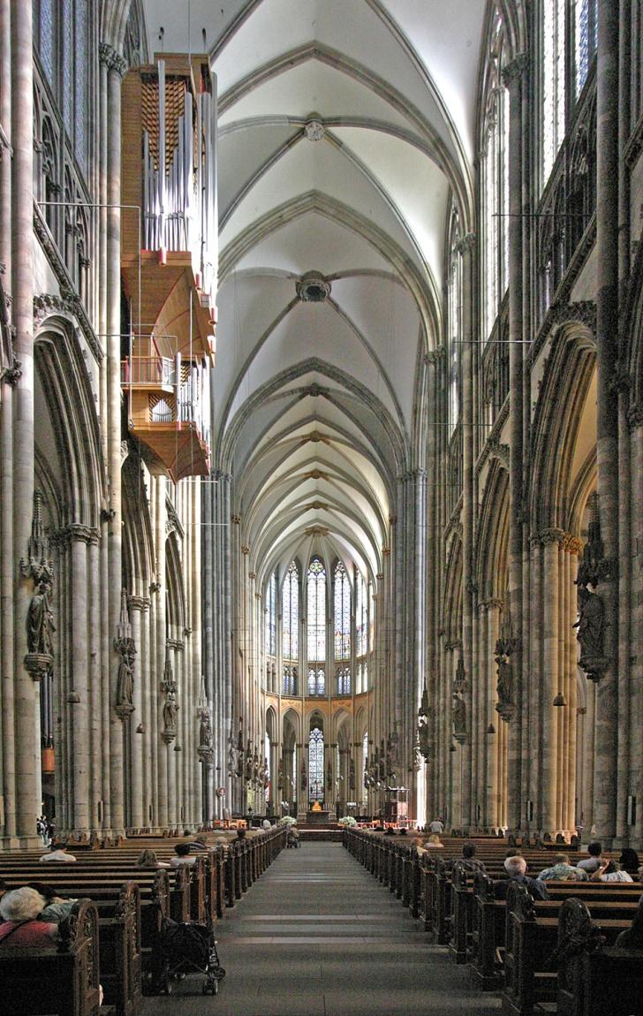
Culture and Arts (cont.)
Cathedrals combined
Architecture
Painting
Sculpture
Inlay
Stained glass
Music
Literature
Painting became more sophisticated after 13th C
Most formal art produced for the Church or clergy
Renaissance reached full flower during 15th and 16th centuries

Slide 52
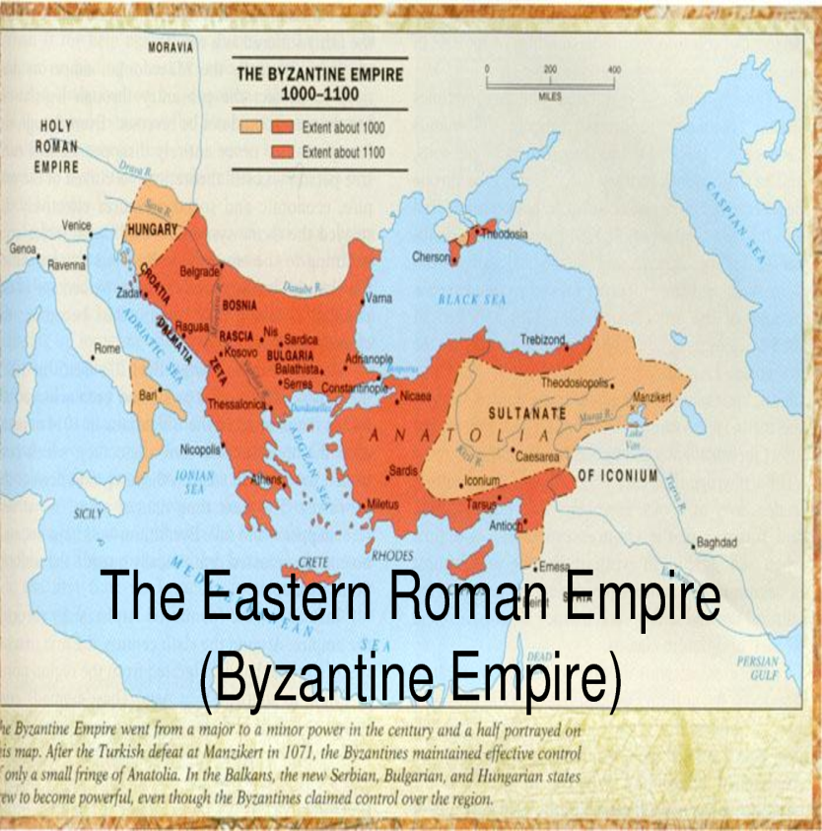
The Byzantine Empire
Lasted almost 1000 years after the Western Empire fell
Controlled the eastern Mediterranean
Inherited Roman authority, roads, communications, imperial institutions
Economic powerhouse with manufactured goods and silks
Influenced by the Slavic people of eastern Europe and Russia
By 12th C weakened with the Islamic states to the east and Slavic people to the north and Western Europe gaining strength.
Survived until 1453; fell to Ottoman Turks and renamed Istanbul

Slide 53
Byzantine Empire: Political Developments
East wealthier and better fortified than the western empire
Sassanids threaten to the east
Constantine claimed divine favor and sanction for his rule
Emperor in the east intervened in theological disputes
Used position to define orthodox (accepted/true) beliefs and condemn others as heretical (false/dangerous)
Political and religious power: caesaropapism (caesar and pope)

Slide 54
Byzantine Empire: Political Developments
Most important of early emperors: Justinian
Hagia Sophia – one of the most important examples of Christian architecture in the world
Major military campaigns to win back lost lands of the Roman Empire
Most important contribution codification of Roman Law; corpus juris civilis (basis for civil law codes that developed throughout much of western Europe)
Empire under almost constant attack
Greek fire

Slide 55
Economic and Social Distinctions
Economy centrally controlled (Constantinople)
Large peasant class
Food prices kept low for urban lower class; hardship for peasants
Location ideal for defense and trade
Brisk silk production
Manufactured cloth
Carpets
Luxury products
Merchants did not have political power (like Chinese)
Merchants in western Europe had greater power

Slide 56
Economic and Social Distinctions
Women found themselves confined to the home
May have concealed their faces when they left home under veils
Only men they socialized with were family members
Empress Theodora had great influence over Justinian

Slide 57
Cultural Achievements
Greek replaced Latin
Influence of classics
Education valued for children of wealthy; peasants and urban workers no formal education
Literacy widespread
Many converted to Eastern Orthodox Christianity
Russia
Romania
Serbia
Bulgaria
Greece
Cyrillic alphabet
Schism in 1054

Slide 58
Byzantium and Russia
Kiev – thriving trading center
Princes sought alliances with Byzantine rulers
Prince Vladimir conversion brought Byzantine influences (marker event)
Art
Cyrillic alphabet
Architecture
Law codes
Missions
After Constantinople fell Byzantine influences lived on in Russia

Slide 59
As 600 – 1450 came to an end..
Western Europe on the rise
Byzantium headed for fall
Leaves lasting imprint on the world’s history through
Law codes
Distinctive architecture
Religion
Organizational structure

Slide 60
The Americas
The emergence of two great empires in this era which unified Mesoamerica and the Andes Mountains area

Slide 61
Western Hemisphere Civilizations
Nomadic groups and subsistence farmers in North America
Complex civilizations in Mesoamerica and around the Andes in South America
Olmec society replaced by the Maya, the people of Teotihuacan, the Toltecs, and eventually the Aztecs
In South America the Chavin was replaced by the Mochica and the Chimu state.
At the end of the era the people of the Americas were in their last days of isolation from the east before the devastation that the 16th century would bring

Slide 62
Societies in Mesoamerica
Classical period ends about 900
Post-classical ends 1450
Note difference from Eastern Hemisphere!
Classical civilizations:
include Maya and people of Teotihuacan
Post-classical:
Toltecs and Aztecs

Slide 63
Classical Mesoamerica: Maya
Heirs of Olmecs were Maya
Ceremonial center at Kaminaljuyu which fell under control of Teotihuacan
Maya moved to poorly drained Mesoamerican lowlands
Built large ceremonial centers with
Pyramids, palaces, and temples, stelae (memorial pillars)
Large cities with peasant populations on the periphery

Slide 64
Classical Mesoamerica: Maya (cont.)
Slash and burn (shifting) agriculture
Terraced farming
Maize
Cotton
Cacao
Cities were religious and administrative centers
Social stratification
Rulers and elite serving priestly and political functions
Tattoos and feathers; elaborate costumes
Kings not divine but communicated with ancestral spirits
Rituals included blood letting and hallucinogenic trances
Large numbers of people to build altars and temples; did not use wheels or metal tools.

Slide 65
Classical Mesoamerica: Maya (cont.)
Religion was central
Pantheon of gods
Human sacrifice
POW – especially elite
Priests had magical powers giving them access to underworld; nine levels of hell
Gods believed to interfere in human affairs, possessing both human and animal traits (jaguar)
Please the gods through bloodletting – victims lacerated before being decapitated to produce more blood

Slide 66
Classical Mesoamerica: Maya (cont.)
Priests constructed elaborate calendars
Solar based on agricultural cycle (365 days) and ritual (260 days)
Wrote inscriptions on temples/monuments and books on paper or vellum
Mayan began to leave cities about 800 CE and within 100 years the cities disappeared
Civil war, epidemic disease, foreign invasions?

Slide 67
Classical Mesoamerica: Teotihuacan
Teotihuacan develops in the highlands to the north of the Maya
Large lakes
Center of religious ritual and government administration
Pyramidal monuments
Pyramids of the Sun and Moon among largest masonry structures ever built
City laid out in barrios
(quarters) for ordinary people.
Also temples, palatial residences,
markets and workshops for craftsmen

Slide 68
Classical Mesoamerica: Teotihuacan (cont.)
No written records; the story is in the stone
Paintings and murals suggest priests important (similar to Maya)
Priests kept calendars for agriculture (similar to Maya)
Cities were centers of extensive trade
Evidence of centralized planning
Collapsed about 750 CE
Walls suggest that later days not as peaceful as earlier
Violent murals
Temples and houses burned

Slide 69
Post- Classical Mesoamerica
Regional states arose; conflicts led to more emphasis on military organization
Capitals on well-defended hills
Art illustrated warriors

Slide 70
Post- Classical Mesoamerica: Toltecs
Toltecs first to unify central Mexico after the people of Teotihuacan
Agriculture included maize, beans, peppers, tomatoes, chiles, and cotton
Centralized state based on military power
Buildings decorated w/warriors and scenes of human sacrifice
Two rulers; most famous was Topiltizin, a priest associated with god Quetzalcoatl (forced into exile)
Replaced by Mexica – the Aztecs

Slide 71
Post- Classical Mesoamerica: Aztecs
Tenochtitlan built where an eagle perched on a cactus with a snake in its mouth
Large city, position on small island in Lake Texcoco, connected by causeways
Chinampas – floating gardens; boosted agricultural production
Tribute system on conquered peoples

Slide 72
Post- Classical Mesoamerica: Aztecs (cont.)
Aztecs rose through military might
Aggressive expansion
Semi-divine king top of social structure
Officials (military heroes) ruled conquered people like feudal lords
Warriors
Free people
Serfs and slaves
Patriarchal society
Women received high honor for bearing warrior sons
Spirits of women who died helped the sun on his journey through the sky each day

Slide 73
Post- Classical Mesoamerica: Aztecs (cont.)
Powerful group of priests
Advisers to the king and officials
Elaborate religious rituals
Chief god, Huitzilopochtli needed blood which came from frequent human sacrifices
Thousands taken captive for that purpose
Cut the heart from a live victim’s chest (with large obsidian knife) which was eaten by the nobility

Slide 74
Mesoamerican Ball Game: Continuity
All enjoyed ball games
Olmec to Aztecs
Large courts in cities with long alleys and side-walls for bouncing balls
Similar to racquetball or volleyball; keep the ball in play
Often featured human sacrifice
Some representations show the balls to resemble human heads

Slide 75
Change Over Time: Classical and Post-Classical Mesoamerica
Lower Population
Land less intensively farmed
Warfare among groups frequent
Small armies, relatively simple forms of government
Population density increased, large cities and overall larger populations
Agriculture intensified (partly due to population increase)
Warfare intensified, more frequent and involved more people as competition for land increased
Centralized, strong governments maintained large armies
Classical (Maya, Teotihuacan)
Post-Classical (Toltec, Aztec)

Slide 76
Andean Civilizations: Moche
After Chavin declined the Moche thrived in the region
Extensive irrigation systems
Cultivated maize, beans, manioc, sweet potatoes, and coca
Stratified society
Wealth and power in hands of priests and military
Wealthy adorned with rich clothing, jewelry, and headdresses
No written records; evidence from tombs reveals ceramics, gold ornaments, jewel, and textiles
Decline not well understood; natural disasters and drought

Slide 77
Andean Civilizations: Comparisons
Unique partly due to their relative isolation to others and the natural environment
Sea coasts
High mountain valleys
Jungles
Only beasts of burden were llamas and alpacas
1. No written language. Records kept on khipus (quipu)
2. Mit’a labor system – workers responsible for certain tasks each year; developed for public works

Slide 78
Andean Civilizations: Inca
Most powerful to occupy region after Moche
Began about 1100
Strong, ambitious leaders began aggressive expansion
Empire 2500 miles north to south
Possible due to agricultural advances: increased food supply
Metal tools
Fertilizers
Irrigation systems
Dams and canals
Terraced farming
Used alpacas and llamas
Surpluses were stored
Mit’a system meant all owed compulsory labor services
Khipu system kept trace owed by communities (alyllus)

Slide 79
Andean Civilizations: Inca (cont.)
Ruler was considered a deity descended from the sun: The INCA
Senior wife a link to the moon
The Inca owned everything in theory; governed as absolute ruler
Status as god-king reflected in elaborate dress (special clothing every day)
Aristocrats and priests led privileged lives with large ear spools
Priests highly educated; many rituals
No distinct merchant class; Inca self-sufficient

Slide 80
Andean Civilizations: Inca (cont.)
Polytheistic
Sun god most important: king was representative on earth
Deceased rulers mummified and displayed during festivals
Each new Inca needed to secure lands in order to support the dead Inca’s mummy for eternity; reason for expansion
Temple of the Sun was center of state religion; mummies of past Incas kept there
Well-organized military and road system
Runners carried messages
Quechua language

Slide 81
Comparisons: Aztec and Inca
 | Aztecs | Inca
Social | Distinctive classes with priests as elites Large middle class of merchants and traders | Distinctive classes with priests as elites No real merchant class; govt controlled trade
Cultural | Religion central to society Human sacrifice Elaborate calendar writing system | Religion central to society Human sacrifice but less central to rituals Quechua native language. No written language
Economic | Tenochtitlan – large city and suburbs Economy based on agriculture Trade important Chinampas | Economy based on agriculture Trade not important Terraced farming Extensive road system
Political | Powerful elite families chose leader Bureaucracy less elaborate Powerful military | The Inca god-king ruled with absolute power and help of large bureaucracy Powerful military

Slide 82
The People of North America
No major civilizations
Variety of people with various lifestyles and languages
Many nomadic
Some agriculture
Anasazi
Multi-storied stone and timber villages connected by roads
Kivas were ritual enclosures for ceremonies

Slide 83
The People of North America (cont.)
Agricultural societies emerged east of the Mississippi
Earthen mounds built as stages for ceremonies, platforms for dwellings, and burial sites
Cahokia – most impressive
No writing and information from archaeological discoveries
Kinship based groups
Alaska to South America nomadism was common
The Aztecs and the Incas were all that stood in the way of the Spanish conquerors when they arrived in the Western Hemisphere in the 16th century

Slide 84
Central and East Asia: the Revival of China and the Impact of the Mongols

Slide 85
After the fall of the Han Empire
Beset by nomadic invasions; fell in the 3rd century
Fragmented into regional kingdoms; 400 years
Era of Division saw bureaucracy collapse, position of scholar gentry decline, large landholders vied for power
Non-Chinese nomadic warlords ruled much of China
Buddhism gained popularity challenging Confucianism
Great Wall poorly defended
Trade and city life declined (similar to Warring States period)
Sui Dynasty established by northern Chinese noble family and reunited China

Slide 86
The Sui-Tang Era
The Sui paved the way for the Tang Dynasty
Sui emperor Wendi was murdered by his son
The Duke of Tang held the empire together and became the first of the Tang emperors
Descended from the Turks who had small states in China after the Han era
Upheld Confucian values
Influenced by cultures of central Asia, including Buddhism
Strong military organization
Capital at Chang’an
One of the most brilliant epochs of China’s long history

Slide 87
Political Organization
Extended borders
Placated nomadic people; played groups off each other and took control
Repairs to the Great Wall
Made leaders of Turkic tribes vassals to Tang rulers
Rulers took title “heavenly khan”
Defeated kingdoms on the Korean peninsula
Tribute from Silla Kingdom
Elaborate bureaucracy needed for the expansion of the empire
Scholar gentry helped offset the power of the land-holding aristocrats; filled most govt positions
Examination system expanded

Slide 88
Political Organization (cont.)
Established regional hegemony through establishment of tributary system
Called empire “The Middle Kingdom”; central to the world around them
Envoys delivered goods with a kowtow
Chinese returned favors with gifs of their own
Ceremonies established diplomatic contacts and encouraged trade and cultural exchanges

Slide 89
Economic Changes and Social Distinctions
Equal field system restricted inheritance of land checking the power of the aristocrats and improving lot of average peasants
Emphasis on scholar-gentry elevated status of bureaucrats
Bright commoners could enter the university (usually with sponsorship)
Birth and family connections continued to be important
Chang’an grew in size
Grand Canal built by Sui linked the Yellow and Yangzi as key component to internal trade

Slide 90
Cultural Developments
Shaped by Turkik and Chinese culture
Continued Confucian exam system
Valued horsemanship
Massive statues of Buddha carved on cliff sides
Tang artists and sculptors focused on horses and camels along the silk road
Literature described foreign foods, music, and customs
Polo popular
Gentlemen expected to write poetry
Li Bo and Du Fu, famous poets, lived during Tang era

Slide 91
Cultural Developments (cont.)
Buddhism influential
Buddhist monk Xuanzang brought hundreds of Buddhist texts from India he used to help people understand Buddhism in China
Monasteries were established
Chan(Zen) emphasized importance of meditation to reach nirvana
Monasteries and temples often provided banking services
Owned land and profited from wealthy patrons

Slide 92
Cultural Developments (cont.)
Mid 9th C Confucian and Daoist rivals attacked Buddhism
Convinced Tang rulers that monasteries were an economic challenge to the government (also couldn’t be taxed)
Under Emperor Wuzong thousands of monasteries and shrines destroyed; lands divided among landlords and peasants
Buddhists never again had as much political influence and Confucianism emerged as the central ideology of Chinese civilization

Slide 93
The Decline of the Tang Empire
Mid-700’s dynasty began to decline; neglectful emperor inspired a rebellion
Troubles began along the northern borders; Uighurs sacked Chang’an and Luoyang
Tang emperors gave more and more power to regional military commanders and gradually lost control of the empire by 907.
China again fell into chaos with warlords competing for regional power. Three states competed to replace the Tang
Liao Empire: pastoral nomads related to Mongols. NE frontier
Xi Xia (Tanggut Empire) in Western China
Song Empire – reunited much of China under central imperial rule.

Slide 94
Song Empire
Constant pressure from northern and western empires
Paid tribute to Liao Empire
Jurchens (northern people) destroyed Liao and exacted tribute from Song
Song relocated capital
Invasion of Jurchens marks division of Northern Song and Southern Song

Slide 95
Political Development of the Song Empire
Never matched the Tang in political or military strength
Subordinated the military to civilian administrators of the scholar gentry class to keep military from becoming too powerful
Rotated military commanders from region to region to weaken power
Scholar gentry filled bureaucracy; political power flowed from aristocrats and Buddhist rivals to Confucian scholar-gentry
Large bureaucracy strained treasury; peasants rebelled when emperors tried to raise taxes
Increased need for military action and increased the debt
Scholar bureaucrats lead the armies with little military education; vulnerable to defeat

Slide 96
Economic Developments of the Song Empire: Industry and Production
Paper-making/book production
Salt and tea processing
Ceramics
Iron industry (military equipment) and tools, nails, etc
Gunpowder
Printing (re-usable, movable type)

Slide 97
Economic Developments of the Song Empire: Commerce
Built off the Sui and Tang
Capital city, Kaifeng, center of trade, guilds
Paper money facilitated trade
Large oceangoing ships
Compass
In the south Hangzhou largest trading city and capital of Southern Song
Silk, copper coins, ceramics

Slide 98
Economic Developments of the Song Empire: Agriculture
Harvests increase during the Song/Southern Song
New strains of rice
Fertilizers
Improved farm tools
Advanced water control
In the south – not disturbed by Jurchen invasion of the north
Contrast to coal and iron industries in the north

Slide 99
Cultural Change in Song China
Appeal of Buddhism led to Neo-Confucianism
Emphasis on the importance of social life and rejection of withdrawal through meditation
Formal education in morals and arts and sciences
Traditions reinforced class, age, gender

Slide 100
Cultural Change in Song China
During Tang and early Song women had more rights
Empress Wu Zhao only woman to rule in her own name in Chinese history
Turned to Buddhism for legitimacy (claimed to be an incarnation)
Over time Confucian writings expressed contempt for powerful women
Created laws that favored men
Late Song the practice of foot binding
Ensured that women would not venture far from home
Lives managed by husbands or male guardians

Slide 101
Other East Asian Societies: Korea, Vietnam, and Japan
All involved in world trade patterns influenced by Chinese political, economic, and cultural developments
Chinese armies invaded Korea and Vietnam
Merchants traded with all three
Buddhism spread
These societies emphasized links to China more than to the wider world
Tended to isolate Korea and Japan
Vietnam had strategic location in the Indian Ocean Trade Basin

Slide 102
Korea
Buddhism became chief religion
Silla kingdom took control of the peninsula
Tributary state to Tang China
Studied Confucianism; prefer Buddhism
Political control in hands of royal family and aristocracy
Aristocratic elite filled the bureaucracy (different from China with examination system)
Artisans seen as servants to elite
No distinct social class for merchants/traders
Replaced by the Koryo Dynasty
Chinese influence peaked
Create pale green glazed bowls and vases: celadon
Superb woodblocks
Experimented with movable type

Slide 103
Vietnam
Resistance and resentment to Chinese conquerors
Absorbed Chinese culture
Agriculture and irrigation
Confucian texts
Some tributary relationships
Buddhism came from China
More devout
Language not related to Chinese
Women had greater influence and freedom than Chinese
Distinct literature
Chinese considered the differences ‘barbaric’
Vietnamese win independence 939 CE

Slide 104
Japan
Developed in isolation
Mountainous; small states developed dominated by aristocratic clans
Isolation meant language and belief system developed unrelated to China
Shintoism
Animistic; nature and spirits
Yamato clan centralized power and established a court modeled on the Tang

Slide 105
Fujiwara Rule
By mid 8th C Confucianism and
Buddhism well established;
Shintoism remained
Centralized government at Nara and Kyoto
Fujiwara family controlled power and protected the empire
Ruling dynasty didn’t change much; didn’t wield much power
Heian Era saw Fujiwara family as the power behind the throne
Elegant lifestyle
Tale of the Genji
Female author Murasaki Shibuku
View of lives of nobility
Struggles for power ensue
Two powerful families; Taira and Minamoto struggle
Minamoto installed as shogun and dominated political life for the next 4 centuries

Slide 106
Japanese Feudalism
Minamoto established bakufu (tent) government
Feudal order developed
Military talent valued
Samurai support lords
Bushido
Seppuku
Era characterized by in-fighting
Rival lords clashed over and shogun’s power challenged (even floors had devices to warn of intruders)
Loyalty emphasized

Slide 107
Japanese Feudalism (cont.)
Western:
More emphasis on written contracts
European knights received land and became lords themselves
Japanese:
ideals of honor, not contracts
Samurai granted land rights, didn’t own land; kept the social division clear
Both had intricate loyalty relationships with Europe’s being the most baffling

Slide 108
The Rise and Fall of the Mongols
Nomadic peoples united under Muslim leaders to conquer territories from Spain to the Middle East, becoming sedentary themselves
Of the many nomadic groups, perhaps the most impressive was the Great Mongol Empire which formed the larges, if not longest lasting, empire of all times

Slide 109
Genghis Khan and the Rise of the Mongols
Strong horsemen
Yurts
Temujin
Sought vengeance (father poisoned)
Reputation for ferocity and brutality
Shrewd diplomat who understood loyalty to allies
Ruled all of the Mongol tribes; universal ruler – Genghis Khan
Organized troops into pyramids of officers (units)
Broke up alliances based on tribes or clans
Highest officials were family members
Armies divided into light and heavy cavalry
Light moved more swiftly
Promotion usually based on merit

Slide 110
Genghis Khan and the Rise of the Mongols
Genghis took the Jin capital (Beijing) and conquered the Xi Xia
Mastered weapons of siege warfare, the mangonel and trebuchet that could catapult huge rocks, giant crossbows mounted no stands, and gunpowder launched in bamboo tubes
Faked retreats
Excellent with bows and arrows
Also went west, conquering vast areas

Slide 111
The Mongols after Genghis Khan
Mongols drove the Teutonic Knights of German back to Vienna (from Russia)
Death of the Great Khan Ogodei (Genghis’ son) spared Europe
Leaders in army called back to elect a new leader
Persia and Iraq not as fortunate
Hulego (grandson) defeated the last Baghdad caliph
Caliph’s relatives fled to Egypt and continued under the protection of the Mamluk Sultanate
Kublai completed the conquest of China (grandson)
Empire stretched from the Pacific to Eastern Europe
After Genghis’ death, the vast realm divided into four regional empires

Slide 112
The Mongols after Genghis Khan
Khanate of the Great Khan
Seen as successor to Genghis Khan
In China, called the Yuan Dynasty
Khanate of Jagadai (Chagatai)
In central Asia
Leader Tamerlane
Khanate of the Golden Horde
Southern Russia
Batu (grandson)
Il-Khan
Hulegu (grandson)
Captured Abbasids capital
Mongol expansion made possible by the superior bows.
Used enlisted men from conquered territories

Slide 113
The Fragmentation of the Empire
Empire split along ethnic lines
Distance between the capital and borders made it impossible to maintain unity for long (similar to large empires before)
Lands separated, weakened and divided by distance and feuds
Mongol rulers also tended to adopt the cultural preferences of the people they conquered (Buddhism, Eastern Orthodox, Islam)

Slide 114
Impact of the Mongols
After the shock of the Mongol attacks, Pax Mongolica was established
Lines of direct communication were established and people traded between east Asia and Western Europe
Goods, people, ideas, and diseases traveled faster than ever before
After the empire broke up, trade along the Silk Road ended and many turned to Indian Ocean trade
Black Death caused millions of deaths and in many ways brought more devastation than the Mongol attacks
Disruptions it caused in Eurasian societies was a factor in the breakup of the Mongol Empire

Slide 115
The Mongols and Islam in the Middle East
Hulegu’s troops stormed Baghdad
Rolled last Abbasid caliph in rug and horses trampled (custom regarding spilling the blood on the ground)
Muslims shocked/outraged; tension in the empire
Il-Khan ruler Ghazan converts to Islam and eventually the Il-Khans declare themselves protectors of Islam
All Mongols ordered to convert
Supported education and scholars
Contributed to the Golden Age of Islam
“Mongols civilized by the Islamic culture”
Illustrates the power of religion as the glue that held societies together at this time

Slide 116
The Mongols and Islam in the Middle East (cont.)
Timur (aka Tamerlane) from the Khanate of Jagadai broke the peace
Attacked area between India and Moscow
Ruled from Samarkand
Ruled through tribal leaders
Turk; opened the door for more Turkish migrations
Osman migrated and settled in Anatolia
Gathered a following
Ottoman Turks
His successors captured Constantinople

Slide 117
The Mongol Impact on Russia
Area divided into kingdoms who didn’t cooperate
Easy to defeat
Kiev in decline
Novgorod agreed to pay tribute and survived
Mongols dominate; Russian princes as vassals of the Golden Horde
Peasants sought protection of nobles and bound themselves to the land
Russians benefitted from the Pax Mongolica through trade
Moscow became tribute collector and spread control over towns who didn’t pay dues; grew wealthier and more powerful
As Mongol power declined, the Moscow princes stepped in to claim power

Slide 118
The Mongol Impact on Russia (cont.)
Russia already shaped by Orthodox Christianity when the Mongols arrived
Cut Russia off from Christian lands to the west, cementing Russian isolation
Europe entering Renaissance Era
Mongols did protect Russia from the Teutonic Knights (military crusading Christian order)
Believed Orthodox Christianity to be heresy

Slide 119
China under Mongol Control
China (Southern Song) militarily and politically weaker than during the Tang
Song paying tribute to Jin Empire of the Jurchens
Song held off the Mongols until Kublai Khan came to power and established the Yuan Dynasty
Never conquered Vietnam or other SE Asian kingdoms
Kublai failed twice trying to attack Japan
Kamikaze (divine winds)
China very ethnically diverse
Confucian scholars saw Mongols as intruders
Kublai kept Mongols as top officials
Dismantled examination system
Scholar gentry greatly reduced in status
Confucians resented Mongols and reasserted their power when Mongols weakened
Many in the Yuan Dynasty were Buddhist and threated deep Confucian roots of China (similar to Tang break-up)

Slide 120
China under Mongol Control (cont.)
Yuan favored merchants
Confucians saw them as inferior
Yuan elevated status of physicians
Confucians saw them as technicians
Yuan encouraged the sharing of Chinese medical and herbal knowledge
Kublai passed laws keeping the Mongol and Chinese identities separate
Chinese forbidden from learning Mongol script
Mongols not allowed to marry ethnic Chinese

Slide 121
China under Mongol Control (cont.)
Kublai was fascinated by Chinese civilization
Retained Chinese rituals and music in his court
Used Chinese calendar
Sacrifices to ancestors
Expanded Forbidden City
Confucianism tolerated
Welcomed emissaries from many lands, including Marco Polo

Slide 122
The Decline of the Yuan and the Rise of the Ming
Failure to defeat Vietnam and Japan undermined strength of Mongols
Successors were weak and bureaucracies characterized by greed and corruption
Scholar-gentry encouraged rebellion against ‘barbarian’ oppressors
Banditry widespread in countryside
Piracy in the open seas
China fell into chaos

Slide 123
Rise of the Ming
Ju Yuanzhang (peasant) founded Ming (brilliant) Dynasty
Renamed Hongwu, the first Ming emperor
Established government model of traditional Chinese dynasties
Revived Confucian educational system and examinations system
Centralized authority at Nanjing
Ming emperors suspicious of non-Chinese
Insisted on absolute obedience
Relied on mandarins and eunuchs

Slide 124
Rise of the Ming (cont.)
Belief that contact with others weakened China and were cautious in trade with outsiders
Trade products included porcelain
Focus on rebuilding the empire to be independent
Repaired irrigation system
Great Wall
Internal trade connections
Promoted Chinese culture
Education
Built a strong China that kept intruders out

Slide 125
Comparison: Customs and attitudes of Mongol and Chinese Women
Patriarchal
More freedom and independence
Wouldn’t bind feet
Formed hunting parties
Wrestled
Advisers to husbands
Politically savvy
Patriarchal
Foot binding
Mongol
Chinese

Slide 126
Tropical Africa and Asia
Including Sub-Saharan Africa, India, and SE Asia

Slide 127
Islam
After the fall of the Abbasid Caliphate Islam continued to flourish
At times spread quietly and others violently
In tropical areas peoples were linked by this common religion and also by increasingly complex long-distance trade networks
The tropical environment:
Temperate climates, monsoon winds, diverse geography

Slide 128
Sub-Saharan Africa
Islam provided external contact between Sub-Saharan Africa and the world
Centers of civilizations arose building from the Bantu migrations
Some very connected with the world
Sudanic empires of Mali, Ghana, Songhay
City states of Swahili coast
Stateless society common and continued to thrive but large states developed and connected economically and politically with other parts of the world

Slide 129
Empires of the Western Sudan
Camels traveled across the Sahel
Ghana
gold for salt and dates (taxed salt and gold exchanged)
Rulers converted to Islam; improved relationship with Muslim merchants and nomads
After decline, Mali grew to dominate the area, followed by Songhay.
The Hausa states became powerful to the east
People of the Sudanic states
farmers (soil sandy/shallow) and fishers
Polygamy common – larger families could farm larger areas of land

Slide 130
The Kingdom of Mali
Ghana fell into decline due to Berber defeats and less gold
Regional leaders battle; Sundiata emerges
Lion-king founded Mali
Stories told by griots
Successive kings made wise alliances
Courageous in battle
Mali successful as trading state
Reached its peak during reign of Mansa Musa
Pilgrimage to Mecca
Market cities included
Timbuktu, Gao, Jenne

Slide 131
Timbuktu
Large population
Great mosque
Library and university
Muslims; provided protection, lodging and services for merchants
Encouraged spread of Islam

Slide 132
Songhay (Songhai)
As Mali declines, Songhay rose
People mostly farmers, herders, fishers
Kings controlled trade
New sources of gold brought wealth
Sunni Ali best known leader
Successors continued to build mosques, support book production
Muslim army from Morocco arrived with muskets; Songhay had no chance

Slide 133
Similarities in Sudanic States of Africa
While they had different periods of greatness, there were commonalities.
Led by patriarch or council of elders
Usually states centered on people speaking common language
Rulers sacred/legitimacy reinforced by rituals and traditions
Rulers converted to Islam, population follows native/animistic faith
Oral traditions/griots highly valued
Connected the region w/the long-distance trade networks of the Eastern Hemisphere

Slide 134
Swahili States
Swahili Coast named for common language
Bantu speaking people and people from across the Indian Ocean settled
Language was Bantu based but Arabic influenced
Cities growing wealthy from trade across Indian Ocean
Chinese porcelains and silks, Indian cotton and glass beads
African Iron, timber, ivory, animal hides, shells and gold.
Kilwa became especially wealthy
Trading cities stretched the length of the coast.
Cosmopolitan cities, mosques, plumbing, multi-storied buildings, wealthy citizens could afford silks, porcelain.
City states were economically connected; no central government

Slide 135
Great Zimbabwe
Inland; traded great quantities of gold with Sofala
Shipped across Indian Ocean
Magnificent stone complex
Walled enclosure
Cone shaped tower
King controlled and taxed trade
Inhabitants not Muslims

Slide 136
Ethiopia
Christian
Ruling elites in Axum may have wanted to enhance relations with Christian Egypt
Islam spread after the decline of Axum until a new ruling dynasty promoted Christianity again
Muslims surround the region; Christians basically cut off from Christians in other lands
Beliefs reflect native African religions
Existence of evil sprits
Carry amulets for protection
African Islam also reflects native religions
Portuguese introduced Roman Catholicism to the Kongo but for the most part, Islam continued to grow

Slide 137
The Spread of Islam to India and SE Asia
Gupta disintegrated
India fragmented into regional kingdoms
Social and cultural conditions were the ‘glue’ that held Indian society together (like the Church in Europe)
Caste system and Hindu religion gave the region its own identity
The arrival of Islam was much more violent than in West Africa or the Swahili Coast

Slide 138
The Delhi Sultanate
11th C Afghan warlords invade
Mahmud of Ghazni leader
Looted Hindu and Buddhist temples; established mosques or Islamic shrines
Successors eventually established the Delhi Sultanate; 1st Muslim empire on Indian subcontinent – not an extension of a Middle Eastern or Persian Empire
Sultans fought Hindu princes for control
Large armies and extravagant courts
Southern India escaped the invasions (small states)
Vijayanagar in the south was an independent empire

Slide 139
The Delhi Sultanate (cont.)
Indians allowed to keep their native religions
Buddhism dwindled
Muslim communities increased
Merchants were the main carriers of the faith; especially Sufis
Welcomed Indians of lower castes
Avoid head tax/marriage
Many remained Hindu; some Muslim princes adopted Hindu customs at court (along caste lines – Muslims leaders on top)

Slide 140
The Delhi Sultanate (cont.) Difficult to reconcile Hinduism and Islam
Equality
Submissive to one god
Muslim ulamas warned against the pollution of Islam by Hindu practices and tried to promote unity in the Muslim community to oppose majority Hindu population
Met stiff resistance by Hindu elites (compare to Africa)
Hierarchical caste system
Many gods
Brahmins denounce Muslims as destroyers and meat eaters
Many believed their religion was superior to Islam; tensions built (compare to Africa)
Islam
Hinduism

Slide 141
Southeast Asia
Expansion of Islam to India set the stage for spread to SE Asia; trade routes across the region
Previously Buddhism and Hinduism; Muslim traders now influence region
Buddhist Shrivijaya trading empire on the decline; helped Islamic influence – Muslim trading centers become established
Most contact peaceful
Spread from Malacca; converts wanted to strengthen ties and prove common basis in Muslim laws
In other areas Sufis allowed natives to keep rituals and local beliefs If paid homage to Allah and followed Islamic doctrine

Slide 142
Two Travelers
Long distance trade increasing by 1000
Encouraged by Vikings, Turks, and Mongols
May have brought destruction, but also new ideas and knowledge
Invaders tended to settle
Pax Mongolica and Dar al-Islam (House of Islam) made travel more appealing
Dar al-Islam
United tropical lands; religious motives were the driving factor
Spoke Arabic/communication
Shared obligation of hajj

Slide 143
Marco Polo
Travels to China and enters the service of the Great Khan (court of Kublai Khan)
Close to twenty years
Captured by soldiers from rival city state Genoa and spends time in prison
Produces a book of his travels
Enjoyed exaggerations; questions as to validity
Sparked great interest in a world beyond Europe
Sense of adventure sets the stage for Europeans to embark on major exploration

Slide 144
Ibn Battuta
Traveled over 73,000 miles
Constantinople, Mesopotamia, Persia, India, Burma, Sumatra, Spain, Mali, and perhaps southern China
Most within cultural area of Dar al-Islam (unified by religion)
Narrated his experiences for a book
Invaluable information about life in Islamic lands

Slide 145
Long Distance Trade and Travel: Patterns, Motivations, and Consequences
Long distance trade at this time relied primarily on the Silk Road and the Indian Ocean
Trade across Sahara increasing
Light luxury goods usually on the Silk Road
Silks and precious stones for example
Bulkier goods by ship
Steel, stone, coral, building materials
Motivations for travel
Trade, diplomacy and missionary activity

Slide 146
Motivations for Long Distance Travel
Diplomacy examples
Byzantine Emperor called on the
Roman Catholic Pope for help
defending the Holy Land
Crusades
Changed Europe forever
Mongols destroyed Abbasid dynasty
Pope Innocent IV sent diplomats inviting Mongols to convert
Ibn Battuta took government positions

Slide 147
Motivations for Long Distance Travel
Missionary examples
Sufi mystics
would tolerate worship of traditional deities but must be pious and devoted to Allah
Roman Catholics
Mongols
China (John of Montecorvino)
Roman Catholic and Eastern Orthodox in Russia

Slide 148
Consequences of Interregional Networks and Contacts
Technological and Agricultural Diffusion
Magnetic compass
Could sail long stretches of water without getting lost
Gunpowder
Used by Mongols to catapult bombs cannons developed; Mongols mainly responsible for quick spread
Food: citrus fruits and Asian rice
Muslims learned to crystallize sugar from cane
Europeans enjoy sugar cubes in their tea and coffee

Slide 149
Consequences of Interregional Networks and Contacts
Spread of Disease
Black Death
60 – 70% of those infected died
Millions in China
Europe lost 25% of population
Disrupted society
In western Europe workers demanded higher wages; rebellions when wages frozen

Slide 150
Consequences of Interregional Networks and Contacts
Demographic Changes
Urban population levels recovered
Tremendous growth of cities along trade routes
Khanbalik, Hangzhou, Samarkand, Baghdad, Cairo, Constantinople, Venice, Kilwa, and Timbuktu
Many merchants traveled the whole distance in pursuit of profit
Nomadic population didn’t recover as easily
Groups never again had the kind of power of the Mongols and Turks
Sedentary people could resist nomadic peoples invasions

Slide 151
Comparisons: Communal vs. Convergent Cities
Uniqueness of cities as they represent the culture of the territories around them
Europe at this time
Paris is uniquely French
London - English
Places where many people of different ethnicities come together to trade, sell arts and crafts, and visit government centers
Emphasize the commonalities
Islamic and Chinese cities
Communal
Convergent

Slide 152
Comparisons: Communal vs. Convergent Cities
Neither theory is completely accurate but they do focus on the fact that European cities were less connected to world trade circuits than Islamic and Chinese cities
London and Paris were not yet the cosmopolitan centers that they would become

