Slide 1
Spain’s Empire and
European Absolutism

Slide 2
A New Spanish Ruler
Phillip II was shy, serious, hard-working and religious. He trusted no one.
In 1556, Philip II begins ruling and its
Possessions
Philip seizes Portugal in 1580
______and from Americas make Spain extremely wealthy
Spain
Gold
Silver

Slide 3
Phillip II
Religion
  Crusader for Catholicism
Philip defends against Muslims, Protestants
Spanish fleet helps defeat Ottomans at Lepanto in 1571
Eventually he was defeated and this ___________Spain.
Catholicism
weakens

Slide 4
Artists in Spain
El Greco and Velázquez
__________uses unusual style to convey religious themes. Used bright colors and distorted figures.
Works of Velázquez show Spanish court life
El Greco

Slide 5
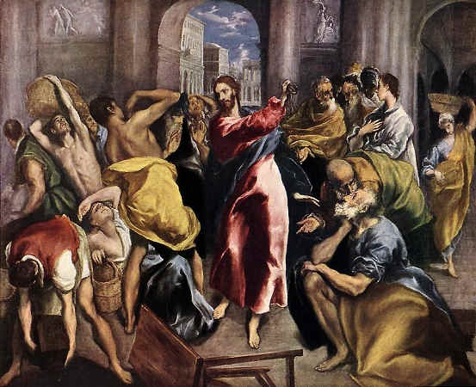
Clashing colors/disturbing images

Slide 6
Don Quixote
In 1605, Don Quixote by
is published
A book about a nobleman that goes crazy after reading too many books about heroic knights.
Novel marks birth of the
_____________________________
Miguel de Cervantes
Modern European Novel

Slide 7
The Spanish Empire Weakens
Inflation
______weakens Spain’s economy
  Inflation –the value of money _____ and the prices of goods _____.
  Two reasons
    ______ in population
    Silver bullion _______ the market
lowers
rise
rise
flooded

Slide 8
Hurting Spain
Taxes on lower class prevents development of _________.
  Kicking out Jews and Muslims (artisan’s left) this left the tax burden on the lower class.
Spaniards buy goods abroad, making Spain’s enemies _____
Philip declares bankruptcy ______ times due to weak economy (German and Italian bankers)
Middle class
rich
three

Slide 9
The Dutch Revolt
Nothing in common
  Dutch Calvinists, not Catholic, strong middle class
Phillip raises ______, tries to crush ____________.
After much violence, and 11 years, the Dutch gain ____________ from Spain
taxes
Protestantism
independence

Slide 10
Dutch Empire
Great Artists such as __________, the greatest artist of the period arise.
  In the Night Watch
Stability allowed focus on ______
Eventually the Dutch replaced the Italians at the _______ of Europe
Rembrandt
growth
bankers

Slide 11
Absolutism in Europe
_____________ _– kings and queens who wanted all of the power within their states boundaries.
Absolute Monarchs believed in ________
_______, God gave them the right to rule and they only answered to God.
Absolute Monarchs
Divine
right

Slide 12
Growing Power of Europe’s Monarchs
Decline of ___________, rise of cities help monarchs gain power
Decline in Church authority also increases power
Crises Lead to ___________
The 17th century is period of great upheaval
Monarchs impose order by increasing their own power
feudalism
Absolutism

Slide 13
PAGE 161
Answer 2, 4, 7, 8

