Slide 1
Chapter 10
The Worlds of European Christendom: Connected and Divided 500–1300

Slide 2
Connected and Divided
For Eurasia, Christianity offered much of what Buddhism did for the Chinese.
Europe became a global center for Christianity.
1/3 of the world’s population at the time were Christians.
Others were in Africa, the Middle East and Asia.
Later, North Africa, Nubia, Central Asia and western China – Christianity vanished as other religions came in.

Slide 3
Eastern Christendom: Building on the Roman Past
Byzantium has no clear starting point.
Many viewed it as a continuance of the Roman Empire.
Christendom was divided into the Eastern and Western halves.
Eastern half persisted for another thousand years.
Housed Byzantium
Wealthier, more urbanized, and more cosmopolitan
Stronger army, navy, and merchant marine as well as clever diplomacy, its leaders were able to deflect the Germanic and Hun invaders who had overwhelmed the western Roman Empire.

Slide 4
Key moments in Byzantium History
Key Moments in Byzantine History
Founding of Constantinople 330
Final division of Roman Empire into eastern and western halves ca. 395
Reign of Justinian; attempted reconquest of western empire 527–565
Loss of Syria/Palestine, Egypt, and North Africa to Arab forces 7th century
Iconoclastic controversy 726–843
Conversion of Vladimir, prince of Kiev, to Christianity 988
Mutual excommunication of pope and patriarch 1054
Crusaders sack Constantinople 1204
Ottomans seize Constantinople; end of Byzantine Empire 1453

Slide 5
The Byzantine State
Emperor Justinian (reigned 527–565) tried to reconquer the Mediterranean Basin
Rapid Arab/Islamic expansion stopped him
Still a power house up to 1200
Generals raised peasant armies and ruled Mediterranean and Black seas.
“Personal freedom in the provinces was constrained more by neighbors and rival households,” concluded one historian, “than by the imperial government.”
After 1085 it shrank from aggressive European Powers, Catholic Crusaders, Turkic Muslim invaders.
Fell in 1453, when Turkic Ottoman Empire took it.

Slide 6
An eyewitnesses lament
And the entire city was to be seen in the tents of the [Turkish] camp, the city deserted, lying lifeless, naked, soundless, without either form or beauty. O city, head of all cities, center of the four corners of the world, pride of the Romans, civilizer of the barbarians… Where is your beauty, O paradise…? Where are the bodies of the Apostle of my Lord…? Where are the relics of the saints, those of the martyrs? Where are the remains of Constantine the Great and the other emperors?…Oh, what a loss!

Slide 7
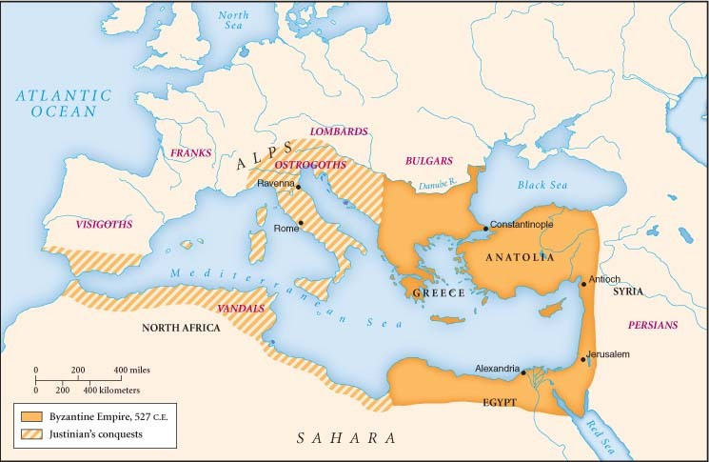
The Byzantine Empire
CAPITAL
The Byzantine Empire reached its greatest extent under Emperor Justinian in the mid-sixth century C.E. It subsequently lost considerable territory to various Christian European powers as well as to Muslim Arab and Turkic invaders.

Slide 8
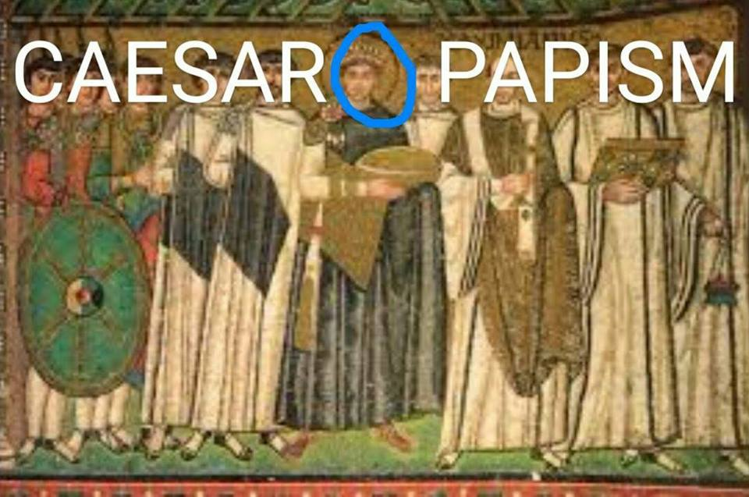

Slide 9
The Byzantine Church and Christian Divergence
In Byzantium, the emperor was Caesar and Pope. The state and church became one. This gave the emperor the power to appoint a patriarch of the church.
There were divisions in the Christian church between the Eastern Orthodoxy and the West.
The Byzantine emperors ordered iconoclasm, a destruction of the many well loved religions images in the Eastern Orthodox church between 726-843 CE

Slide 10
Christianity
Eastern Orthodox
Western/Latin Christianity
Ruler is a reflection of the glory of God on earth
Forbade use of icons
Grew beards
Permitted to marry
Leavened bread for communion
Excommunicated the west
Allowed icons
Shaved
Remained celibate
Unleavened bread for communion
Excommunicated the east

Slide 11
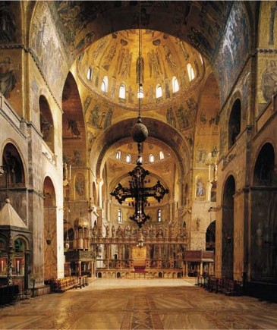
St. Mark’s Basilica
Consecrated in 1094, this ornate cathedral, although located in Venice, Italy, is a classic example of Byzantine architecture. Such churches represented perhaps the greatest achievement of Byzantine art and were certainly the most monumental expressions of Byzantine culture.

Slide 12
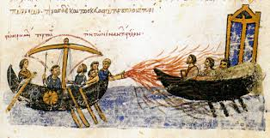
Byzantium and the World
Interacted with its neighbors politically and militarily
Persia quickly became part of the Arab world.
Byzantines used “Greek fire” (Oil, sulfer and lime through a bronze tube) to keep Arab away.
Central player in long distance trade
Kept much of Greek learning.

Slide 13
The Conversion of Russia
Kievan Rus is a third wave civilization spurred by trade.
Prince Vladimir of Kiev had to pick a religion to unify his people.
He chose the religion of Byzantium, Eastern Orthodox Christianity.
Orthodox Christianity had spread mostly to Ukraine and western Russia.

Slide 14
The Conversion of Russia
He borrowed Byzantine architecture, the Cyrillic alphabet, extensive use of icons, monastic tradition stressing prayer.
When Moscow fell to the Muslim infidels, it was considered the “Third Rome”.

Slide 15
Society and the Church, 500–1000
Fragmented and decentralized societies brought about feudalism.
In the absence of Roman authority, this way of living was the only security available to many.
Much like Buddhism’s appeal to the Chinese after the fall of the Han dynasty, Christianity made many promises after the fall of the Roman Empire.
Although often little more than a collection of quarreling principalities, the Holy Roman Empire emerged out of Otto I of Saxony's efforts to renew Roman rule in the tenth century.

Slide 16
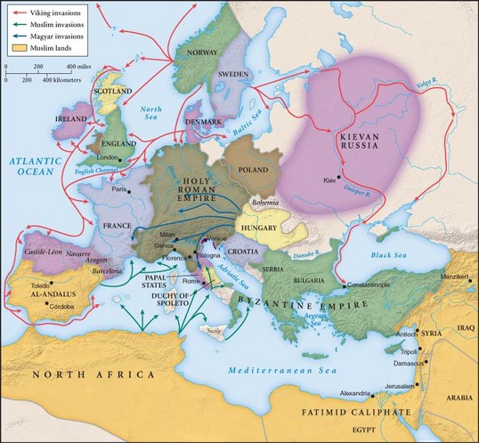
Accelerating Change in the West, 1000–1300
The Magyar (Hungarian) and Viking invasions disrupted and threatened post Roman Europe.

Slide 17
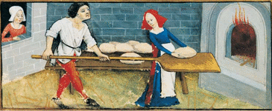
Accelerating Change in the West, 1000–1300
Europe grew drastically paralleling that of China’s movement to the south.
Land was cleared for farming. People didn’t think removing all of the trees would do any harm.
Huge growth deteriorated women’s opportunities.
Outside of monastic life, Beguines, laywomen, Practiced the same lifestyle the men did with celibacy,
Were poor, and dedicated their lives to weaving and working with the sick and poor.

Slide 18
Europe Outward Bound: The Crusading Tradition
Expansion during this time period was a given. Europe was looking to increase contact with their more distant neighbors.
The Arabs and Turks were both moving into the Byzantine Empire and there was pressure to expand.
As part of the wider Western European expansion, the Vikings set off around 1000 C.E. on a maritime transatlantic venture that established colonies in Iceland, Greenland, and Newfoundland.

Slide 19
Europe Outward Bound: The Crusading Tradition
As Eastern Christendom was falling, the Crusades were springing up.
Participants vowed and were given indulgences
- removed penalties for confessed sins
- immunity from lawsuits
- moratorium on repayments of debts
The contradiction of war and Christianity was not seen.
The Crusades were a series of wars attempting to stop the takeover of, or take back lands from Islam. They were unsuccessful

Slide 20
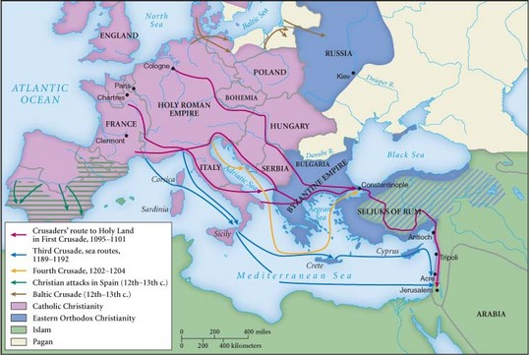

Slide 21
Europe Outward Bound: The Crusading Tradition
Thousands of Europeans were in contact with the Islamic world and began a love of finer goods.
Cross-Cultural exchange spurred contact and created a greater divide between Eastern and Western Christendom. This still exists today.
With all of the trade, Wester Europe was still not more economically developed than their counterparts.

Slide 22
Reason and Faith
The idea of using reason was one that was growing and personal autonomy was growing for individuals. People listened to Aristotle and others to help them with reason. They tried to keep a divide between reason and faith.
Students at a school in France asked their teacher to provide proof of God, only through reason and not the Bible or divine revelation. This was the first idea of natural thought.

Slide 23
Reason and Faith
Slowly and never completely, the scientific study of nature, known as “natural philosophy,” began to separate itself from theology. In European universities, natural philosophy was studied in the faculty of arts, which was separate from the faculty of theology, although many scholars contributed to both fields. This was applied to law and medicine as well.
Enthusiasm for rational inquiry stimulated European scholars during the High Middle Ages to seek out original ancient Greek texts, particularly those of Aristotle.

Slide 24
Reason and Faith
Aristotle’s writings became the basis for education in Universities.
In the work of the thirteenth-century theologian Thomas Aquinas, Aristotle’s ideas were thoroughly integrated into a logical and systematic presentation of Christian doctrine.
In this growing emphasis on human rationality, at least partially separate from divine revelation, lay one of the foundations of the later Scientific Revolution and the secularization of European intellectual life.

Slide 25
Reason and Faith
In 529, the emperor Justinian closed Plato’s Academy in Athens, claiming that it was an outpost of paganism. Its scholars dispersed into lands that soon became Islamic, carrying Greek learning into the Islamic world. Church authorities as well were suspicious of classical Greek thought, sometimes persecuting scholars who were too enamored with the ancients.
They also did this with Galileo and Copernicaus.

