Slide 1
CHAPTER 14
Revolution and Nationalism

Slide 2
Revolutions in Russia
Czar’s of Russia continue an autocratic rule and oppose reform of any kind.
Non-Russians are treated harshly!
Pogroms (violence against Jews) break out.
Tension grows
Factories Double, but they are still behind the rest of the world.

Slide 3
Working Class
Like US / Europe, working class upset over poor working conditions and wages.
Marxist ideas grew popular
Proletariat (workers) will rule
Marxist followers split into two groups
Mensheviks – moderates
Bolsheviks – radicals
Bolsheviks would sacrifice EVERYTHING for change

Slide 4
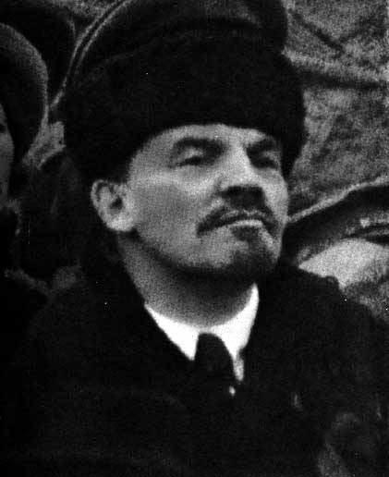
Vladimir Ulyanov
Also known as Lenin
Leader of the Bolsheviks
Led the Bolshevik Revolution
Organized, ruthless, left to avoid being arrested but stayed in touch so he could return when it was safe.

Slide 5
Results of the Revolution
Truce with Germany
Factory control returned to the workers
Farmland distributed to the peasants

Slide 6
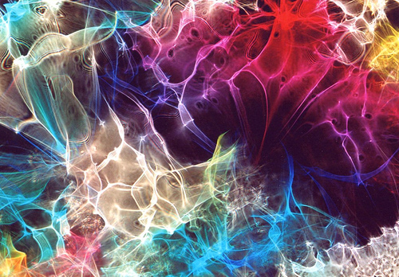
RUSSO- JAPANESE WAR
Russia and Japan competed for control of Korea and Manchuria. They both sign treaties to avoid fighting, but Russia breaks the treaties.
Japan retaliates by attacking Russia at Port Arthur.
News of the losses spread and sparked unrest that led to a revolt

Slide 7
Bloody Sunday
January 22, 1905 200,000 workers and families approached czar Nicholas II’s Winter Palace in St. Petersburg. * (He was against reform)
- Petitioning for: better working conditions, personal freedoms and an elected national legislature.
Nicholas II- Orders open fire More than 1,000 wounded and several hundred died.

Slide 8
Yes... I can't believe the news today Oh, I can't close my eyes And make it go away How long... How long must we sing this song How long, how long... 'cause tonight...we can be as one Tonight... Broken bottles under children's feet Bodies strewn across the dead end street But I won't heed the battle call It puts my back up Puts my back up against the wall Sunday, Bloody Sunday Sunday, Bloody Sunday Sunday, Bloody Sunday And the battle's just begun There's many lost, but tell me who has won The trench is dug within our hearts And mothers, children, brothers, sisters Torn apart Sunday, Bloody Sunday Sunday, Bloody Sunday How long... How long must we sing this song How long, how long... 'cause tonight...we can be as one Tonight...tonight...
Sunday, Bloody Sunday Sunday, Bloody Sunday Wipe the tears from your eyes Wipe your tears away Oh, wipe your tears away Oh, wipe your tears away (Sunday, Bloody Sunday) Oh, wipe your blood shot eyes (Sunday, Bloody Sunday) Sunday, Bloody Sunday (Sunday, Bloody Sunday) Sunday, Bloody Sunday (Sunday, Bloody Sunday) And it's true we are immune When fact is fiction and TV reality And today the millions cry We eat and drink while tomorrow they die (Sunday, Bloody Sunday) The real battle just begun To claim the victory Jesus won On... Sunday Bloody Sunday Sunday Bloody Sunday...

Slide 9
WWI
WWI 1914-1918
Nicholas II enters Russia
Moved to the war front
Russian soldiers mutinied and showed that Russia was weak and unprepared to enter the war.

Slide 10
Czarina Alexandra
Ran things at home.
Son was a hemophilia
Rasputin- mystical powers eased son’s symptoms
Alexandra repaid Rasputin by letting him make political decisions.

Slide 11
Can’t Fix It
Nicholas could not fix things so he steps down.
A provisional government of local councils takes over.
Lenin returns to Russia and aids in a Revolution

Slide 12
Bolshevik Revolution
Bolsheviks
- gain control – Rename the Communist Party
- sign treaties w/ Germany to get out of war.
Civil War breaks out.
Lenin- New Economic Policy
- Restores Russian economy
1922 Lenin renames the country U.S.S.R (Union Of Soviet Socialist Republics)

Slide 13
Joseph Stalin
Lenin dies- Joseph Stalin takes over.
Enacts a totalitarian govt.
Govt. that dominates every aspect of life.
Established collective farms, 5 year plan, “Great Purge”
Command economy – unrealistic goals
Leads to agricultural and industrial revolutions

Slide 14
Imperial China
Collapses

Slide 15
Nationalists overthrow Qing Dynasty
Kuomintang
Nationalist group
Pushed for modernization and nationalism
Approved by the world
Sun Yixian
Leader
Overthrew the last emperor

Slide 16
Chinese Communist Party
Mao Zedong starts party
China’s greatest revolutionary leader
Believed in bringing Marxist ideas to the rural areas instead of urban areas

Slide 17
Tiananmen Square
Means “Gate of Heavenly Peace”
Site for political activities
1989 Students protested for political reform. Thousands were gunned down, hundreds killed.

Slide 18
Clash in China
Chinese Nationalists and Communists clash. Internal conflict spurs war.
Nationalist leader Jiang Jieshi surrounds the communists.
The Communist peasants take a 6,000 mile trek to safety in the north.
Long March
China’s internal battle ends when Japan attacks them.

Slide 19
Nationalism in India and SW Asia
Two parties
Congress and League
Both parties want S. Asia to become independent of British Rule
Great Britain says they will give them reforms toward independence if they assist them in WWI. – They lie.

Slide 20
Amritsar
In 1919, 10,000 Hindus and Muslims gather at the city of Amritsar.
British troops are ordered to open fire.
1200 wounded-400 killed.
This became known as the Amritsar Massacre
People all over the world are angered by this

Slide 21
Mohandas Gandhi
Leader of the independent movement
His ideas blend religions
Urges civil disobedience – peaceful protests
Boycott British goods: schools, taxes, elections
This affects the British economy and they give India self rule.
240 mile walk to collect sea water for salt. Salt March

Slide 22
British tries again…
Britain tries to take Persia after WWI.
Spurs nationalist movement and revolt.
1921 Reza Shah Pahlavi takes power of Persia and modernizes.
1935- Renames it Iran
1920’s – 1930’s – European/American companies find large oil deposits in Iran, Iraq, Saudi Arabia, Kuwait. - Poor $ into countries = rapid growth

