Slide 1
From Hunter-Foragers to Settled Societies
We really moved up in the world
Created By: Drew Yanuszeski
@ Korea International School

Slide 2
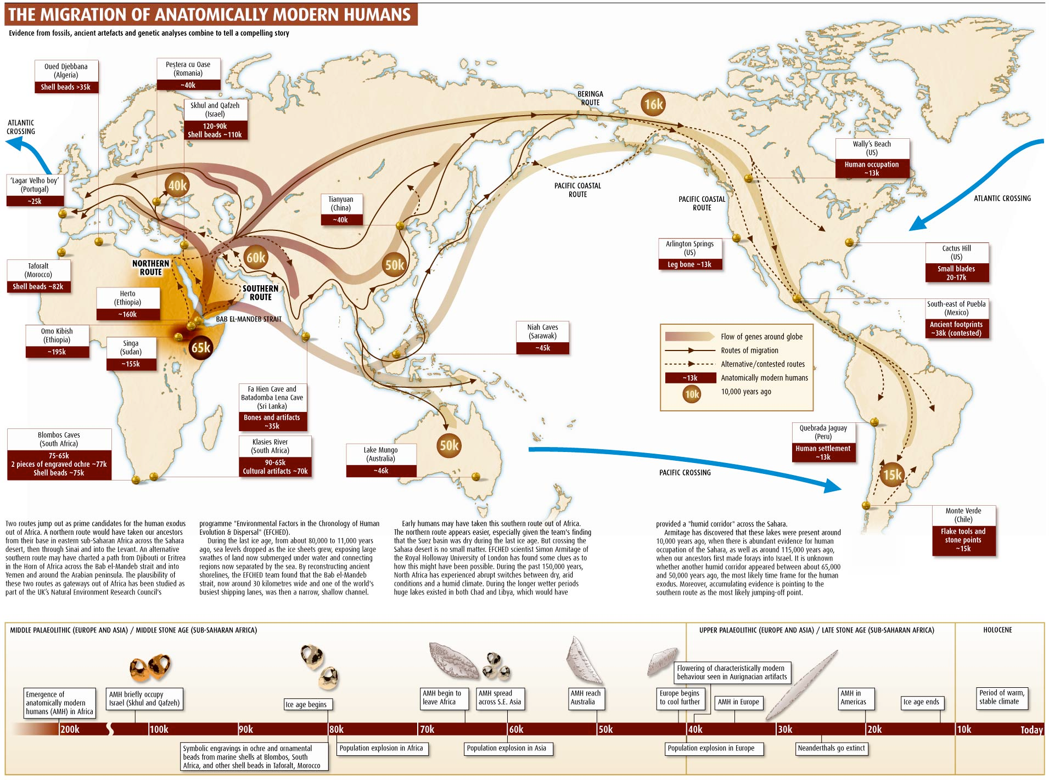
The Migration out of africa

Slide 3
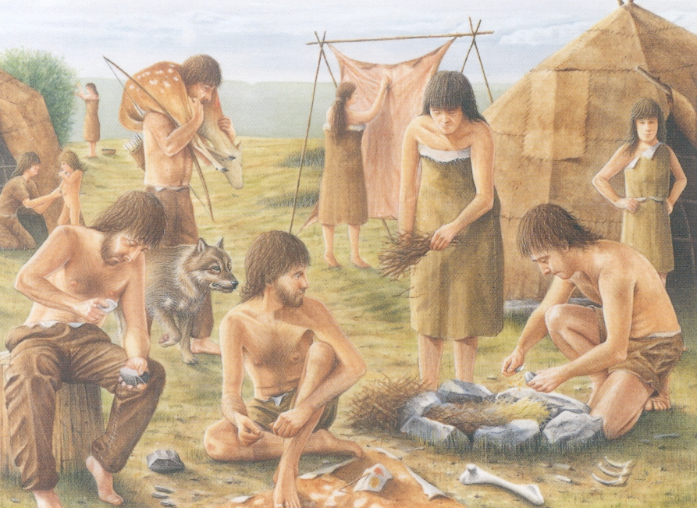
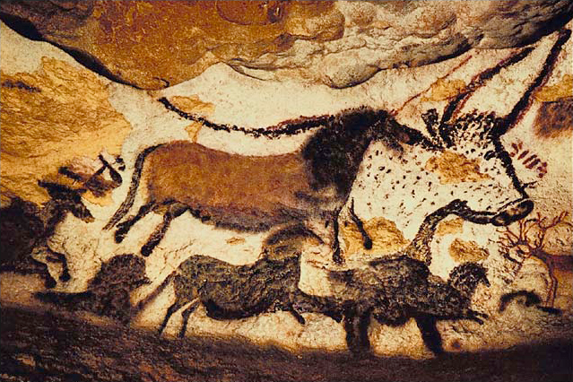
Early Palaeolithic Period
Began 2.5 million years ago and ended about 10,000 years ago, aka the Stone Age
Adapted to their environment, typically hunter-gatherers
Known for controlling fire
Defined roles for men and women
Had a role for religion and art, but don’t know much about religion.
Artwork can show us how the climate has changed over time

Slide 4
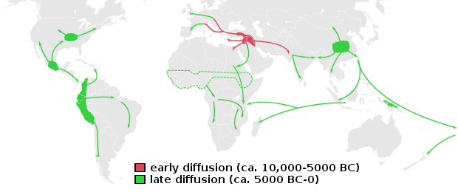
Neolithic revolution takes place
10,000 years ago, or 8,000 B.C.E.
Happened because of a warming in the climate after final Ice Age
This did not take place instantly everywhere, different areas experienced their own revolution at their own times
Characterised by these major developments: Agriculture, Pastoralism, Specialization of labor, Development of Cities, Governments, Religions, and Technology

Slide 5
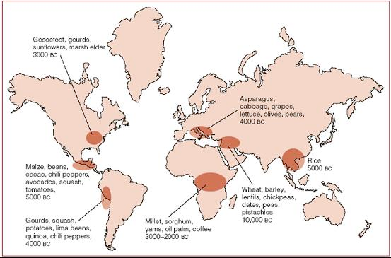
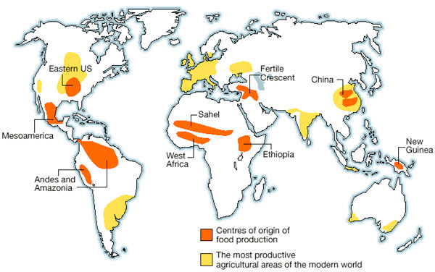
Agricultural Revolution
Because of the warmer climate, they were able to grow crops
For the first time they had a Surplus of crops
They domesticated crops already growing in the region and learned how to store them for long periods of time
This limited their diet…. why?

Slide 6
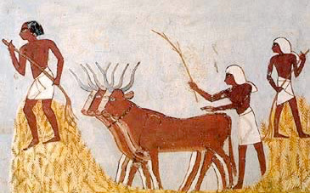
Pastoralism
The process otherwise known as the domestication of animals
First animal domesticated was the dog
Used to be nomadic pastoralism, only a few stayed in one place
Had dramatic effects on the environment
Because they were nomadic, they were responsible for spreading ideas and trading goods among different groups of people

Slide 7
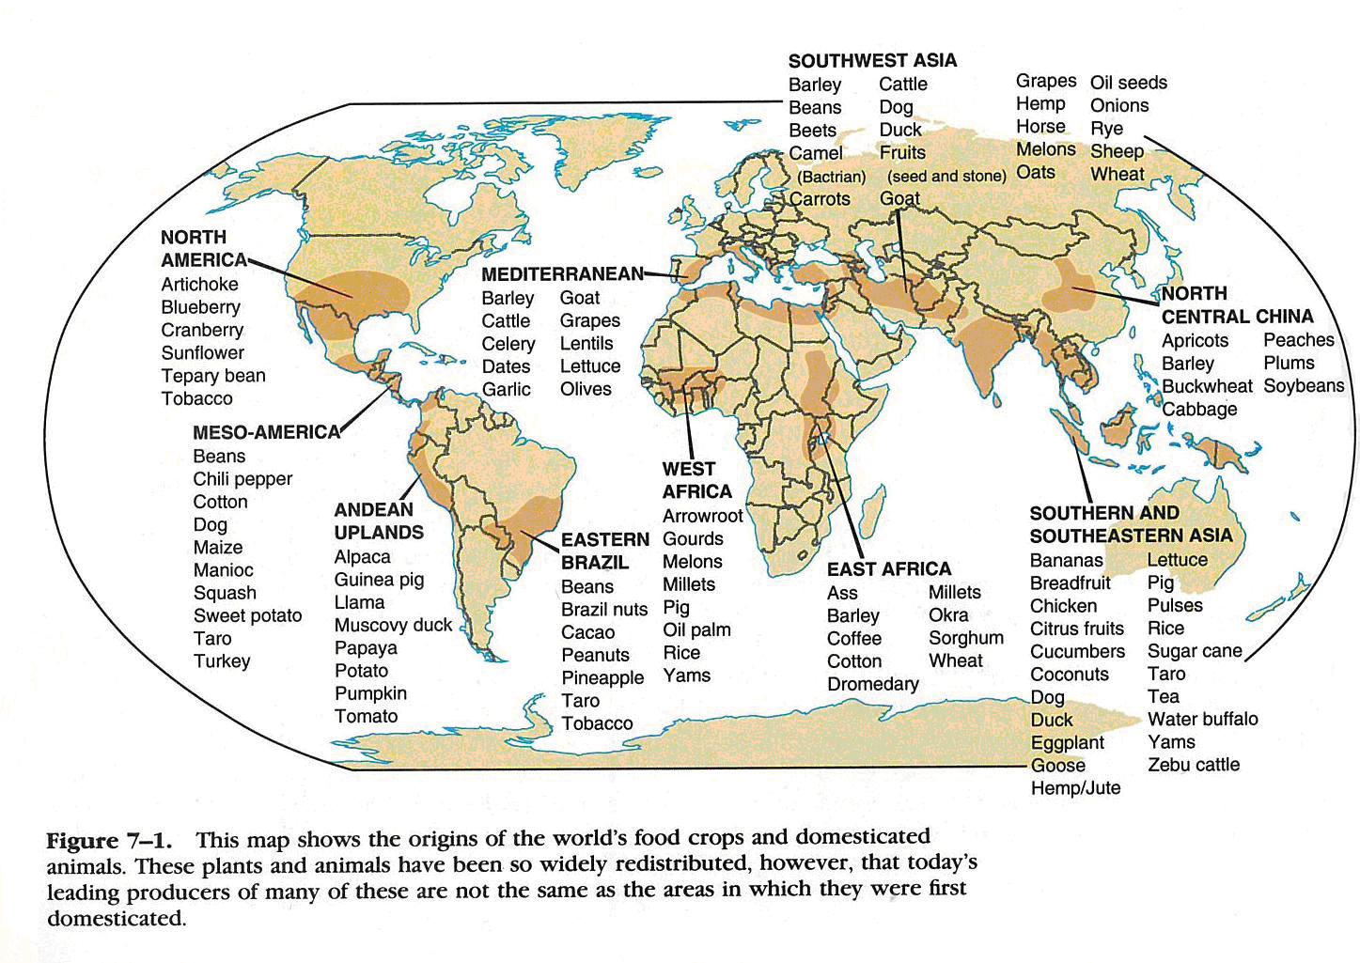
Bring it all together now…

Slide 8
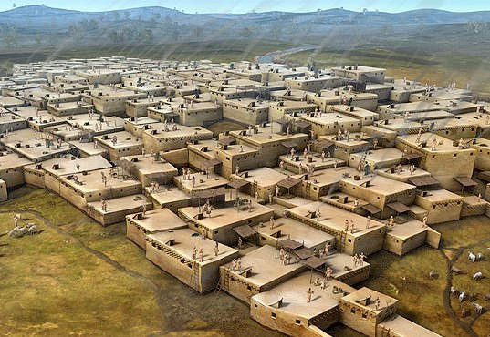
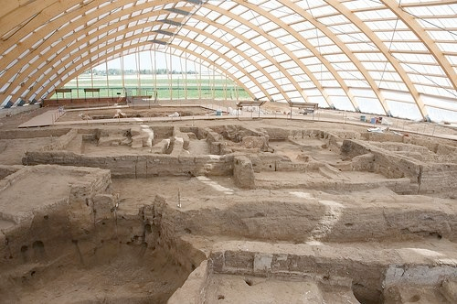
Growth of villages, towns, and cities oh my!
Because of food surplus, permanent settlements began to take place
Then came the idea of social stratification
One of the first cities was Jericho along the Jordan River, then Catal Huyuk in Turkey
Cities led to many different classes of people

Slide 9
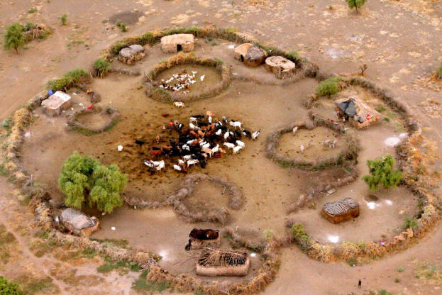
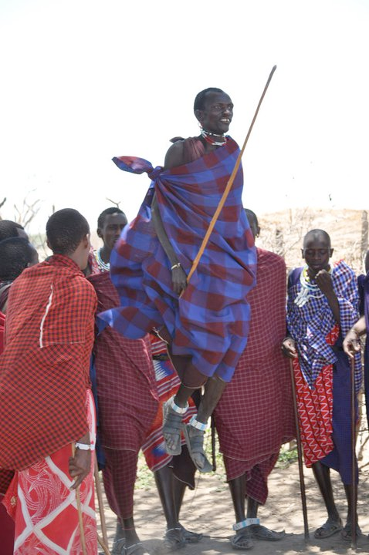
Governments form
Because people needed to work together to clear land, irrigate farmland, figure how to distribute the surplus, they needed a government
Soldiers were then created to protect their food and land from outside invasions
Typically those who became the most wealthy through land and livestock became the leaders. Was not till later that skill on the battlefield was needed

Slide 10
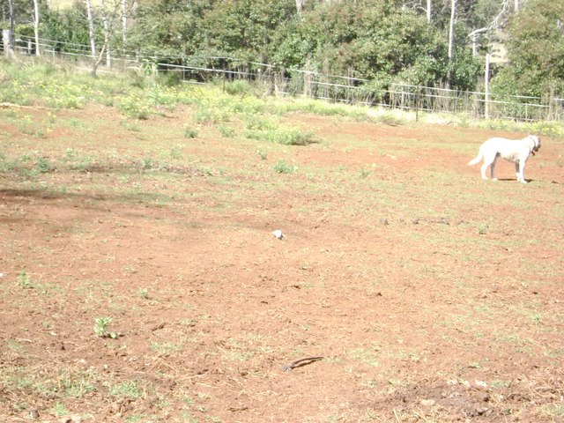
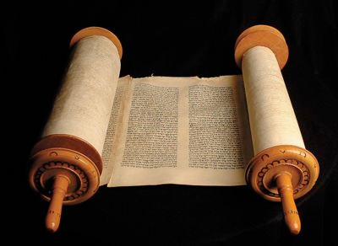
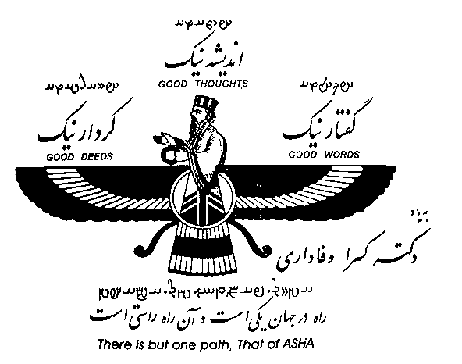
Religions
We know how lands can loose their fertility today… so how can they?
People needed a reason why back then, so they turned to religion, typically polytheistic
In 600 B.C.E. Hebrews emerged under the leadership of Abraham and created the first monotheistic religion
In South-east Asia you had Vedic religions, and in Iran the religion of Zoroastrianism was formed, the first which focused on an eternal battle between good and evil

Slide 11
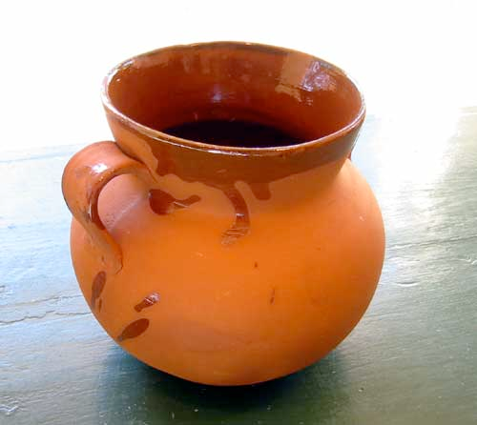
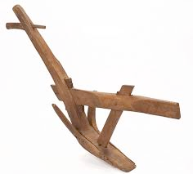
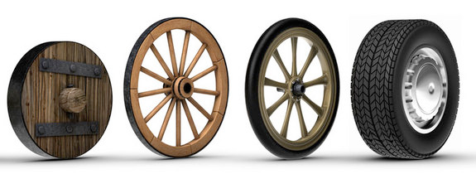
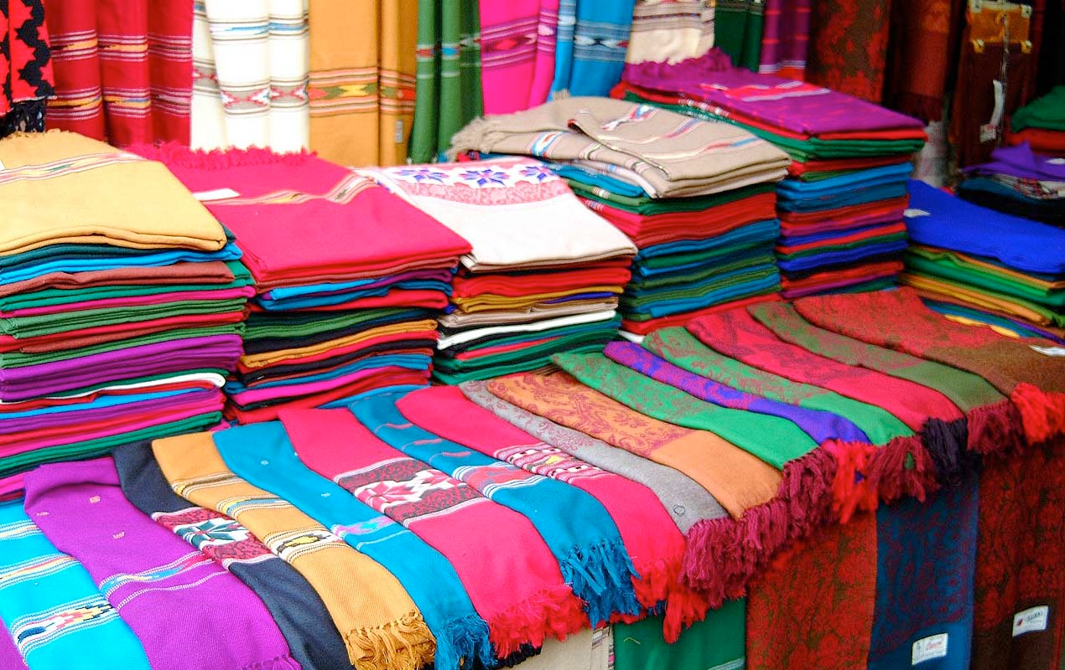
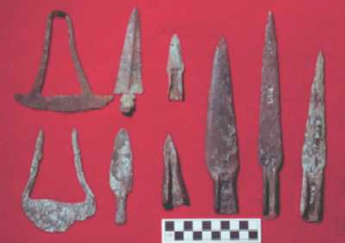
Technological Innovations
These advances were made typically in one place, and others independently… how did they learn them?
Clay Pots
The Plow
The Wheel!!!!
Production of Textiles… aid cloth
Finally, metallurgy: The science and study of metal AKA the Bronze Age

Slide 12
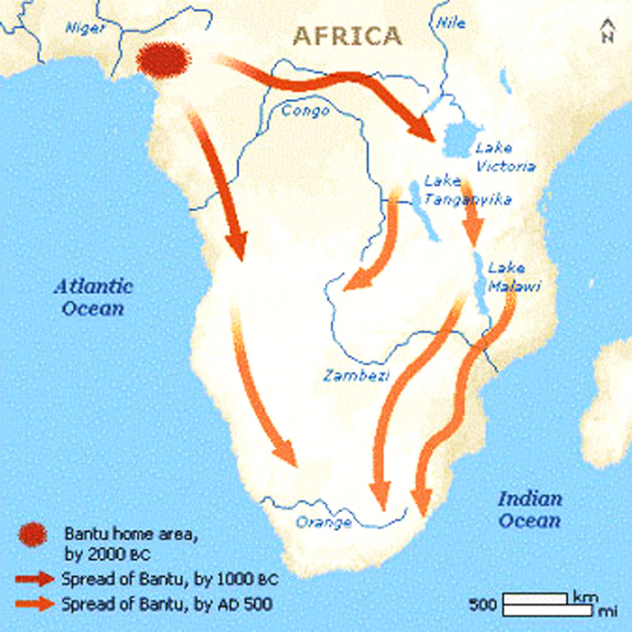
Can’t forget the bantu because they did!
Lived in clan-based villages and spread out as their villages grew in population
Brought with them Cattle and Sheep, as they were the currency of the clans, and still are
Traded with one-another and also spread faster thanks to iron metallurgy

Slide 13
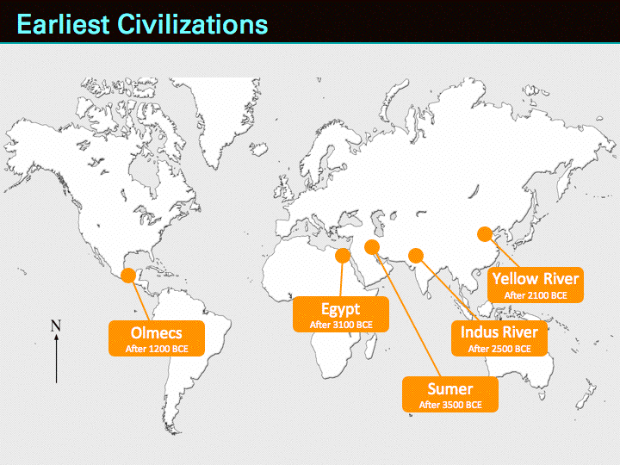
What all of this means: THE FIRST CIVILIZATIONS!

