Slide 1
The first civilizations
The main points, from the main civs, along the main rivers

Slide 2
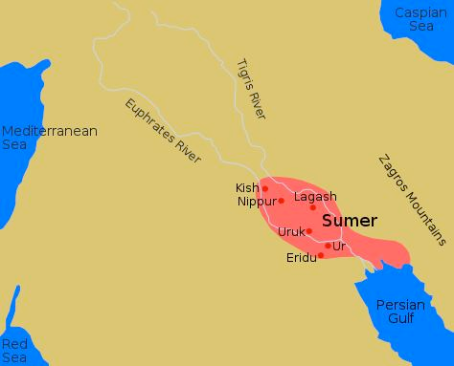
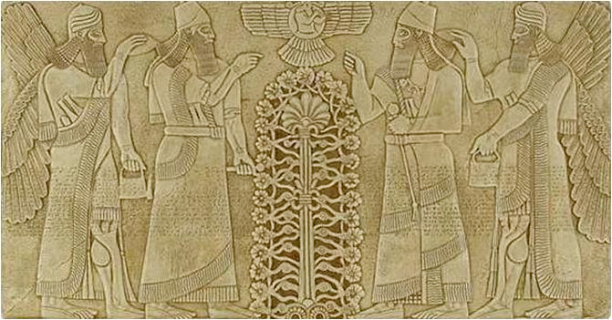
The sumerians
Sumer was the first civilization to form along the Tigris and Euphrates rivers called the Fertile Crescent
The entire area is known as Mesopotamia
A group of different city-states with the largest being Uruk
Military leaders became more important than priests and became known as kings

Slide 3
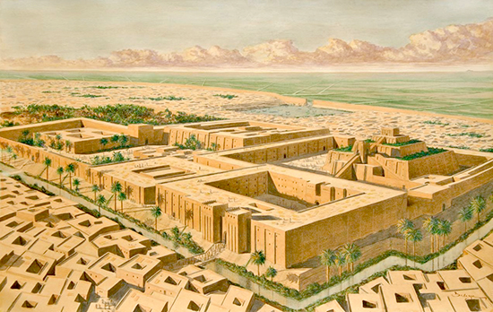
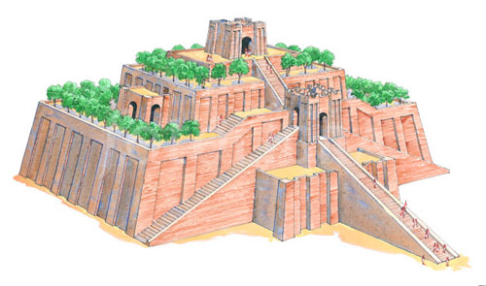
Sumerian Culture/ Economy
People were Polytheistic with priests leading service because flooding was so unpredictable
Traded their surplus through the Persian Gulf into the Arabian Sea, and into the Mediterranean Sea
Traded for Gold from Egypt, Tin from Persia, and beads, wood, resin, lapis, lazuli, and obsidian from Southeastern Africa… also pearls, copper, and ivory from India
Gap between the rich and poor increased, but there grew a middle class including..
Merchants, farmers, and professionals such as architects.
Hired workers made up the lower class, then there were slaves

Slide 4
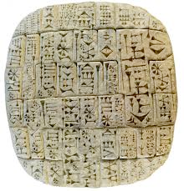
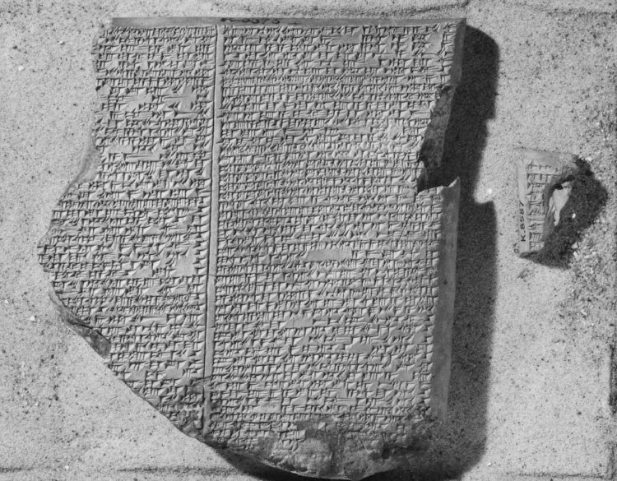
More on Sumerian Culture
Upper-class women enjoyed some freedom and could own property with separate incomes from their husbands
Created the world’s first writing system called Cuneiform, created by scribes
Invented sundials, the 12 month calendar, and the oldest written story, the Epic of Gilgamesh
Eventually they fell off…. why?

Slide 5
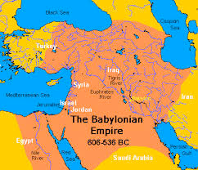
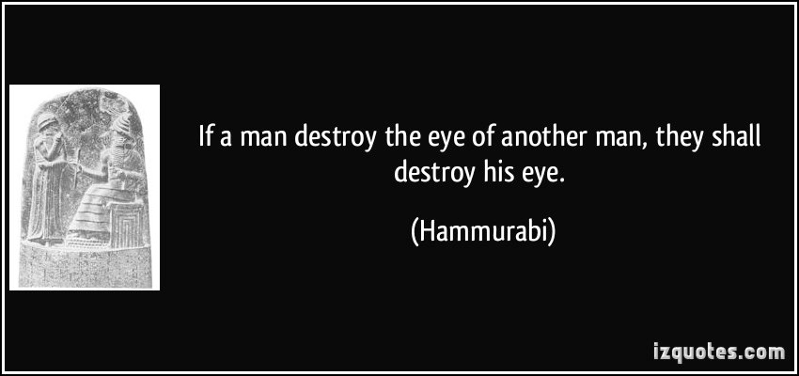
Babylon’s turn
The first kingdom to be called an empire
Most powerful king was Hammurabi who created a set of laws called Hammurabi’s Code
Similar to Sumer, but marriages were arranged by parents and a wife could leave her husband if he was cruel, but could not divorce him. In the end still was a Patriarchal society
studied Astrology and Astronomy

Slide 6
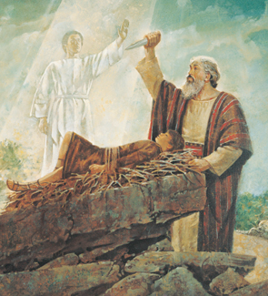
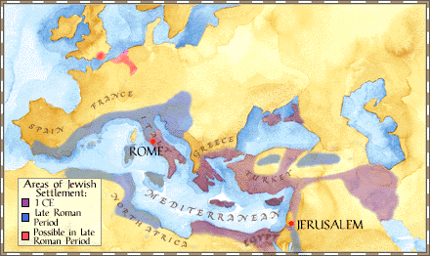
Hello Hebrews!
Became known as the Israelites and later Jews
Founded by Abraham, but forced to leave Canaan due to drought and went to Egypt
Where Moses led them out of Egypt to current-day Israel
Thanks to being conquered by the Assyrians and the Babylonians it led to the Jewish Diaspora

Slide 7
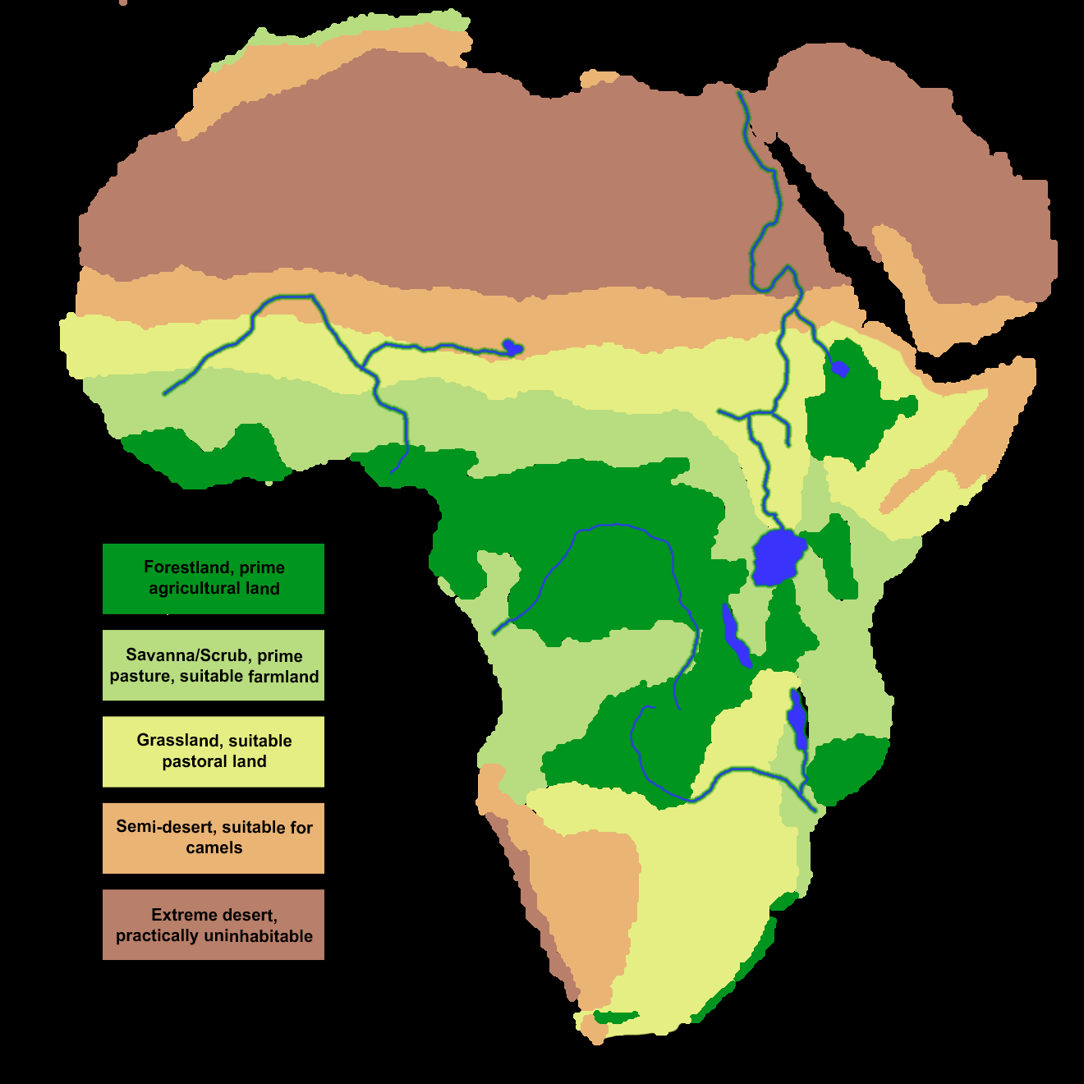
Africa is just… Geographically weird

Slide 8
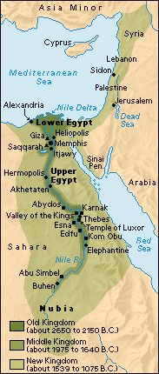
Ancient Egypt!!
Ancient Egypt founded along the Nile River, used yearly river flooding to fertilize the land.
Due to climate change around 5,000 B.C.E it forced people from the savannah in north Africa (yes it used to be green) to the Nile River Valley
Used the river for transportation and trade. Egypt is split into three different kingdoms: Old, Middle, and New

Slide 9
Out with the old…
When the old Kingdom fell, it split into Upper and Lower Egypt

Slide 10
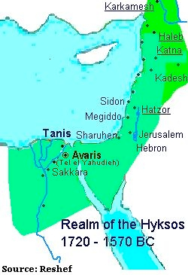
The middle kingdom
Egypt was reunited by Mentuhotep II by taking power away from local governors and having a bigger army
The Pharaohs had sculptors and artists depict them as wise and caring
Irrigation was increased to add more farmland
Kingdom ended with the invasion of the Hyksos from Syria, used chariots and better bows and arrows to beat them

Slide 11
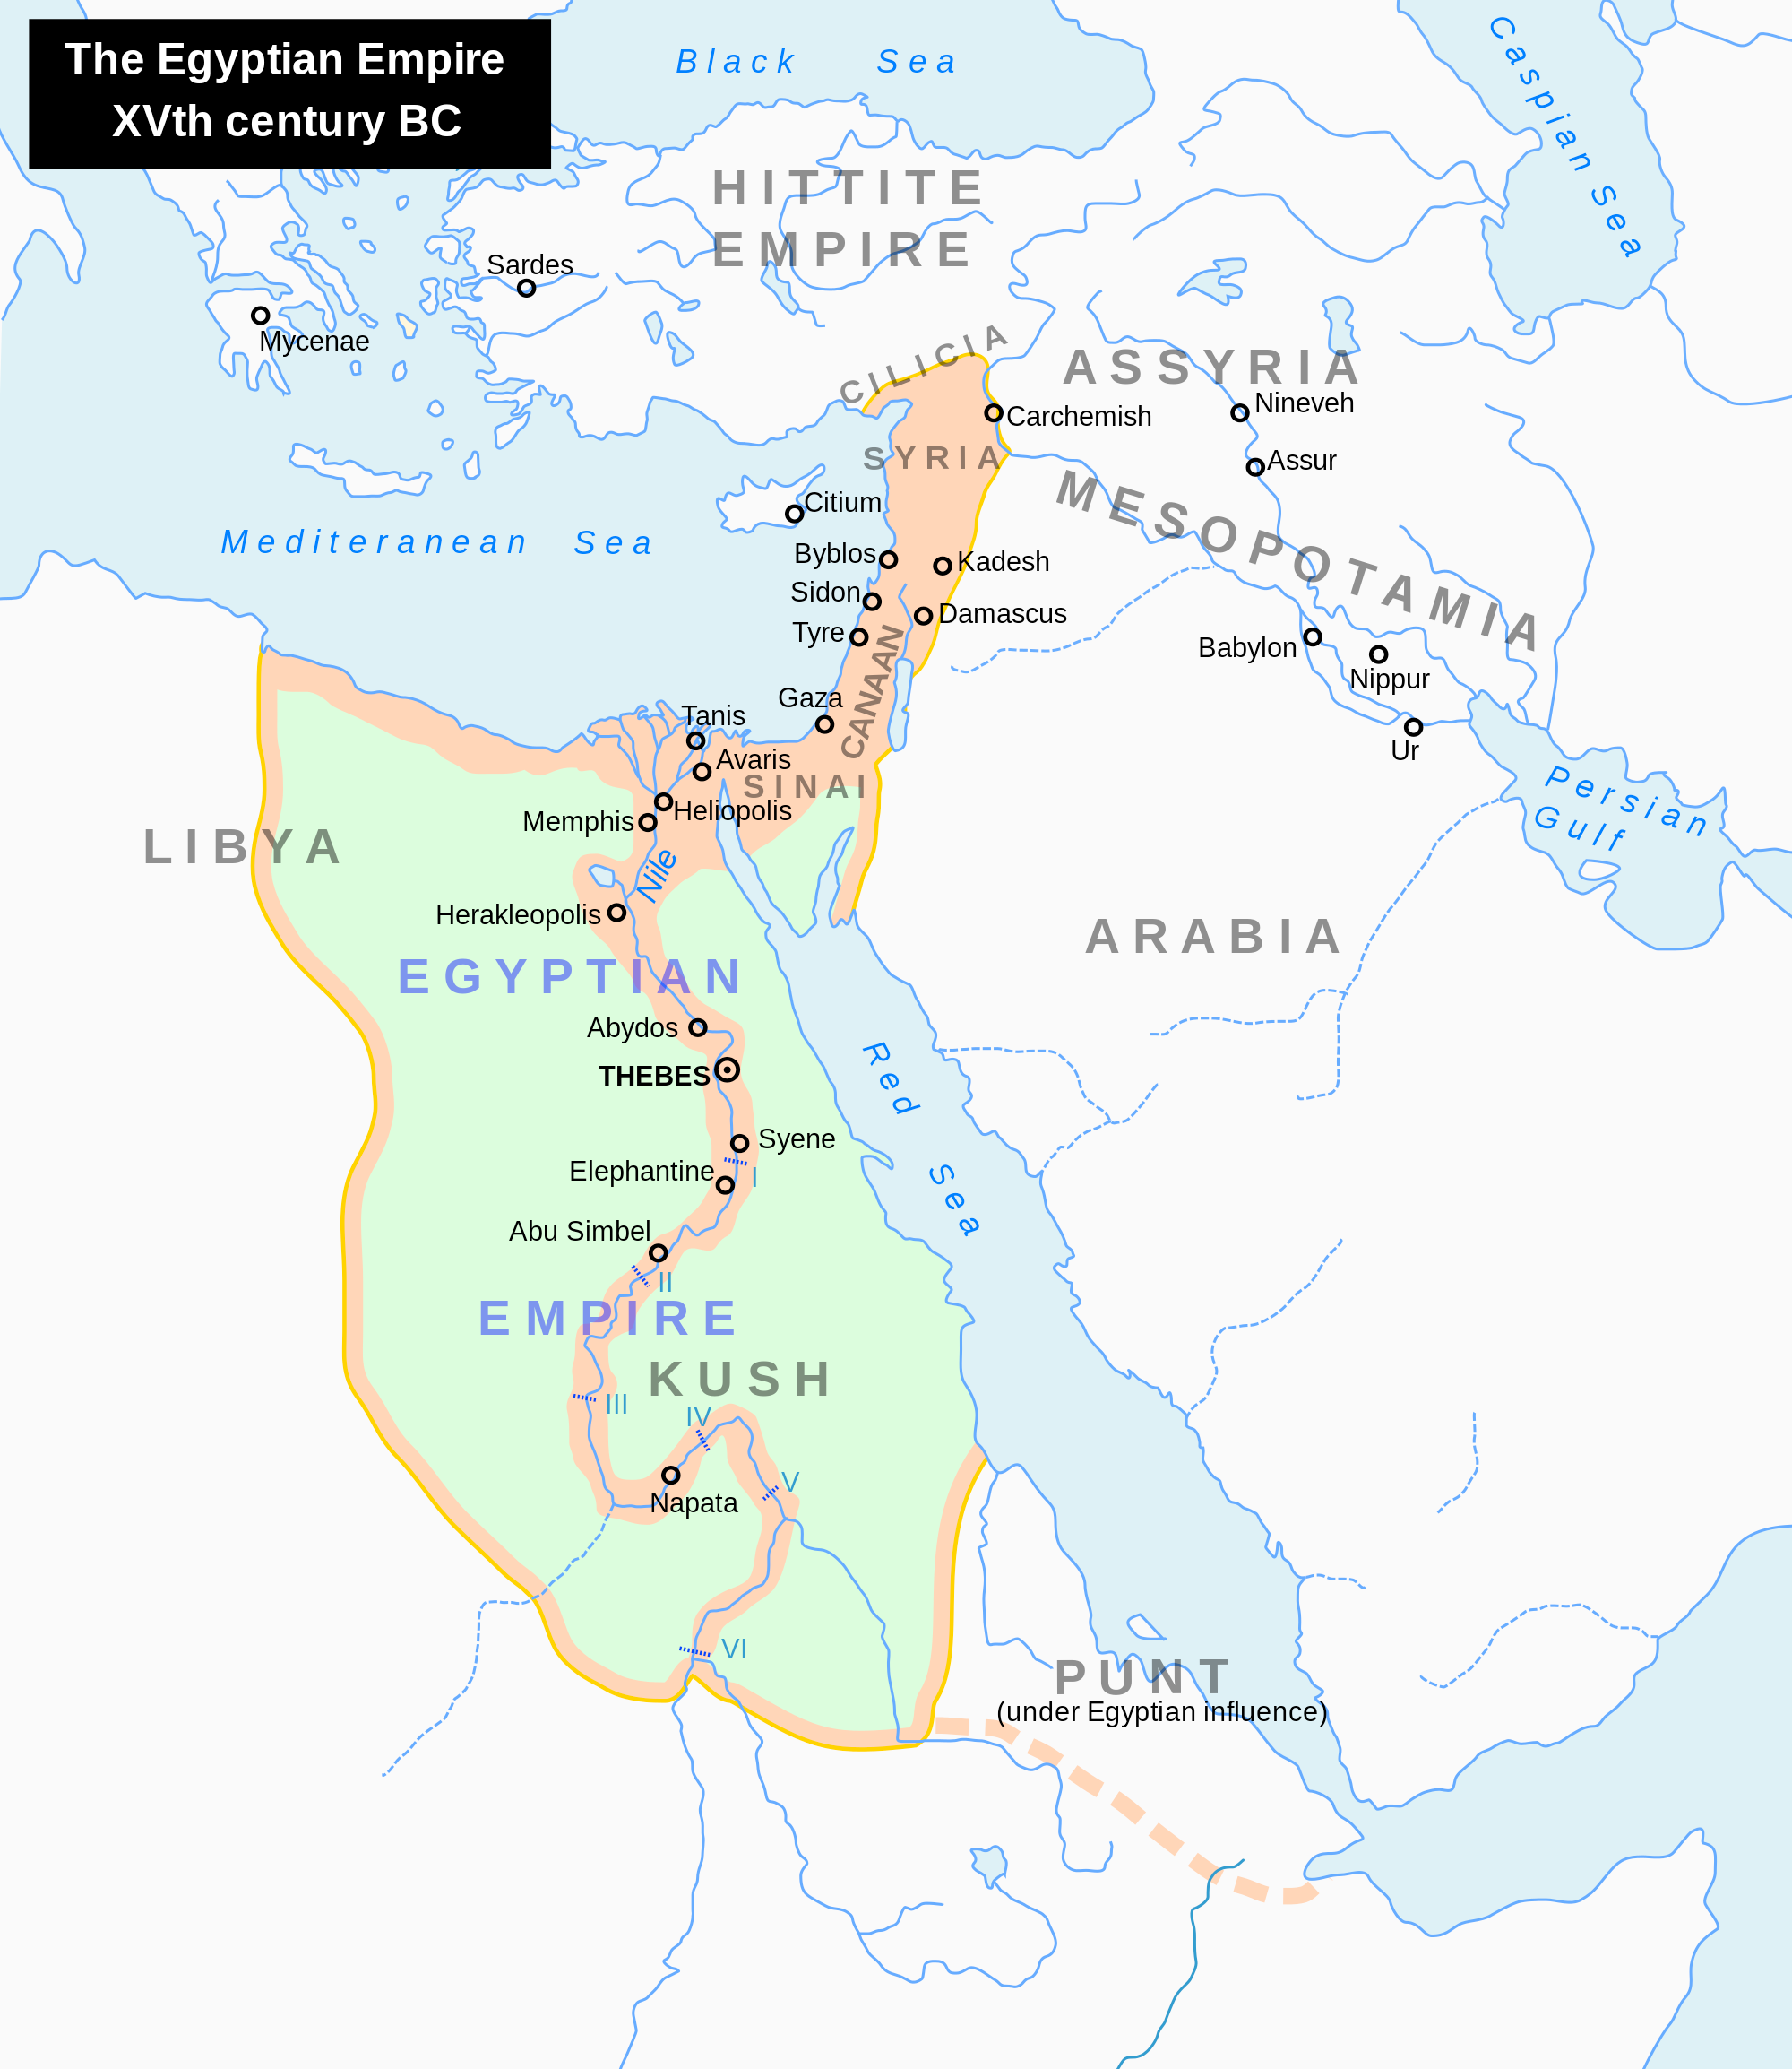
New Kingdom
The guys to know…
Akhenaton- tried to call for the worship of one god, Aten the sun god
Ramses the Great- built more temples and erected more statues than anyone else
After Ramses… they started to fall

Slide 12
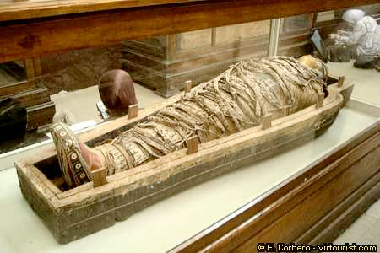
Egyptian Culture
In Egypt, the class system was rigid, but everyone was equal under the law… except slaves
All about Mummification, preserving their bodies for the afterlife and taking some of their possessions with them
Used a form of writing known as Hieroglyphics, and wrote on papyrus, a type of plant like paper
A Book of the Dead was buried with each person telling their story
They also developed a number system based on 10, and created a calendar to track the stars for religion and monitor the flooding of the Nile
Life expectancy was only 35 years and 1/3 of infants died

Slide 13
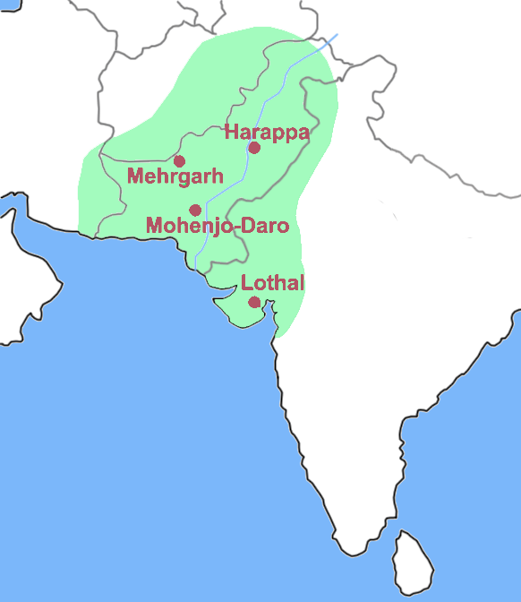
Indus valley civilisations

Slide 14
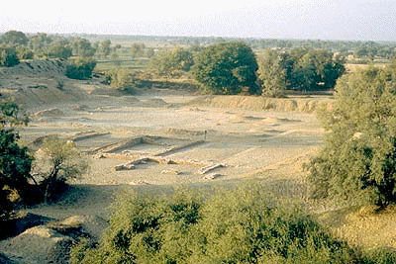
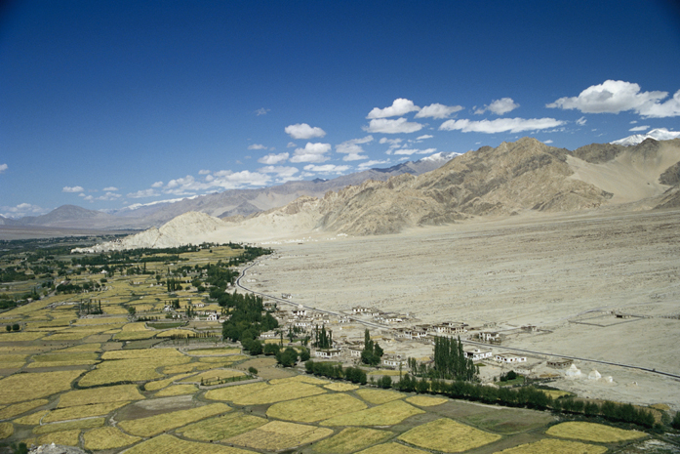
Harappan societies and Mohenjo-Dara came and went
Traded by sea and land with Egypt
Environmental degradation caused the gradual decline and disappearance of the civilisations
Removed to many trees causing the soil to erode
Could also have been earthquakes

Slide 15
Aryan Culture
Each tribe was divided into Clans, with no central government
used the barter system
Developed a form of writing known as Sanskrit, evolved the language into Hindi
Aryans brought horses to the Indian peninsula
All about the Vedas…

Slide 16
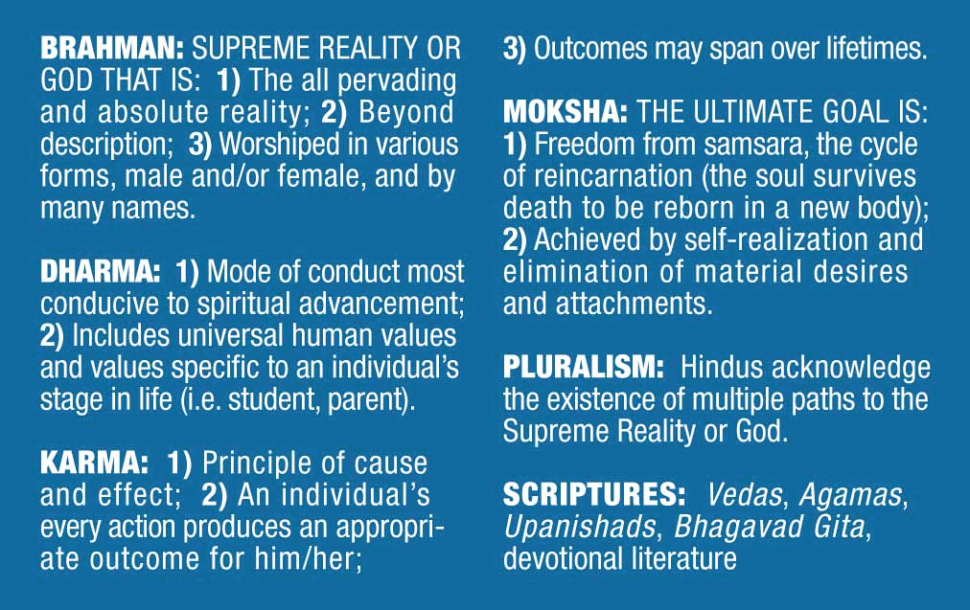
Vedas main religious concepts

Slide 17
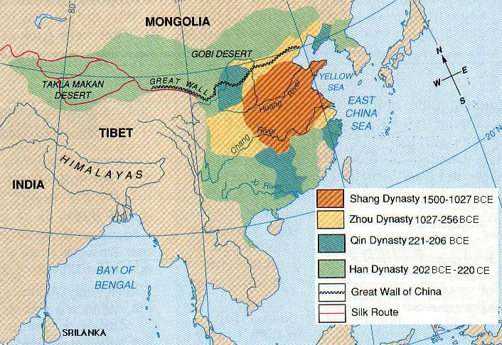
On to CHINA!!!!

Slide 18
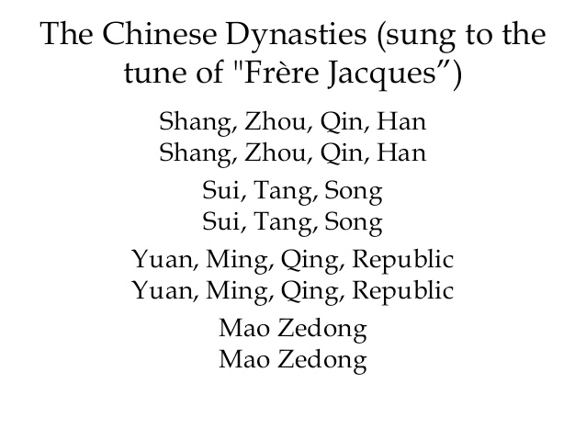
Chinese dynasty song

Slide 19
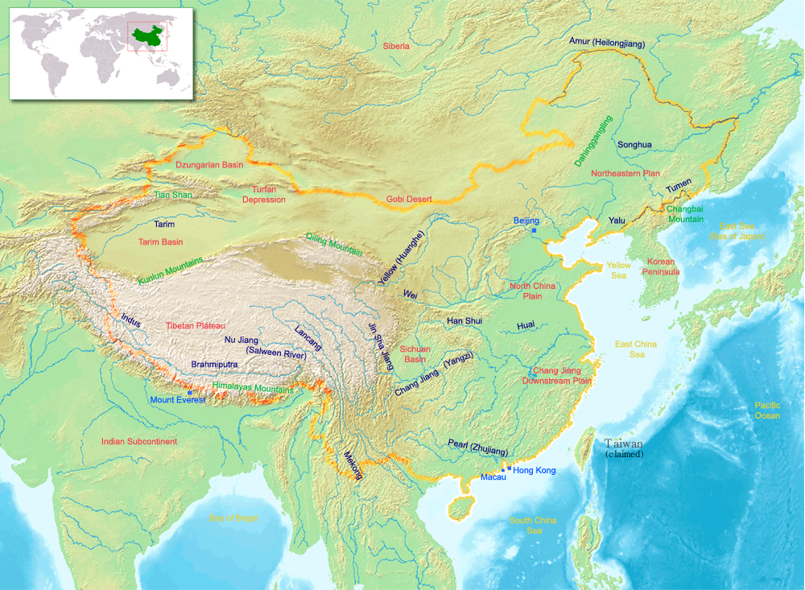
In the beginning…
Very well protected from invasion with the Gobi Desert, and the Himalayas, and to the north… there was nothing
Started with the Xai Dynasty which lasted for about 400 years, but don’t know much about them really at all…

Slide 20
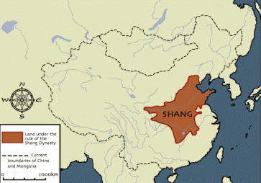
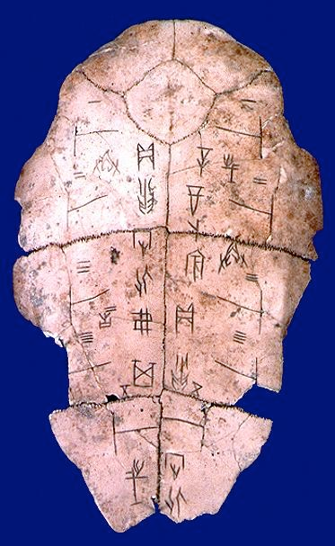
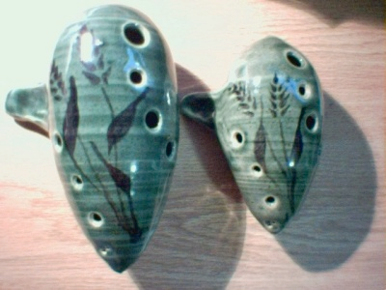
The Shang Dynasty
Was around for about 600 years
Controlled all copper and tin mines, and kept a monopoly over all bronze in the country, so their armies were amazing
They were polytheistic, but believed that several different gods controlled the forces of nature
We know of their writing system because of the Oracle bones
Tradition of ancestor veneration began here and through that they believed in life after death
Also created a 365 day calendar with 12 alternating months of 29 and 30 days, they did add extra days when needed

Slide 21
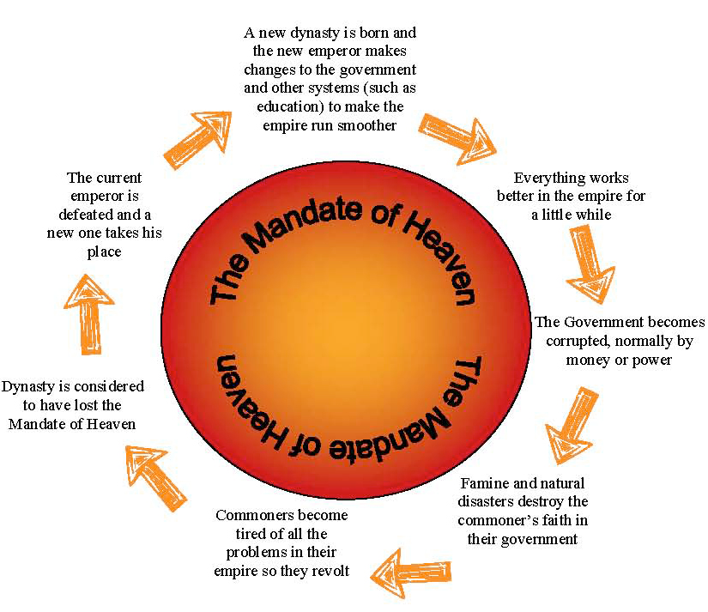
The Zhou Dynasty
A military man named Wu raised his own army and challenged the Shang rule, he was killed, but the dynasty fell
Zhou kings ruled for about 900 years
Created the idea of the Mandate of Heaven
invasions, earthquakes, and droughts were thought to be signs from the gods that the kings had lost the mandate

Slide 22
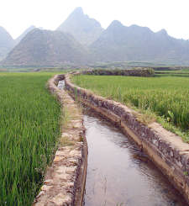
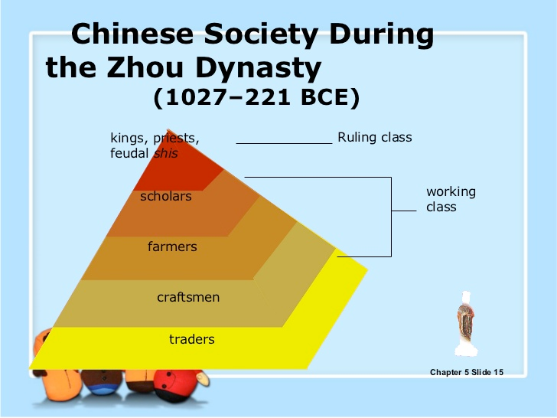
Finishing off the Zhou
Practiced Feudalism, so the region had many city-states and all answered to one ruler
farmers did not typically own the land they farmed on
Iron weapons and tools rose in prominence, they built dikes, dams, and irrigation to farm more than ever
Farmers had to devote a number of days of labor for government projects
By the end, the city-states fought each-other for control and led to the period of the waring states

Slide 23
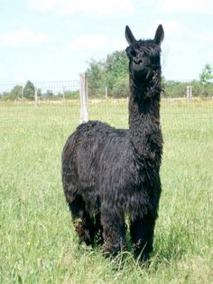
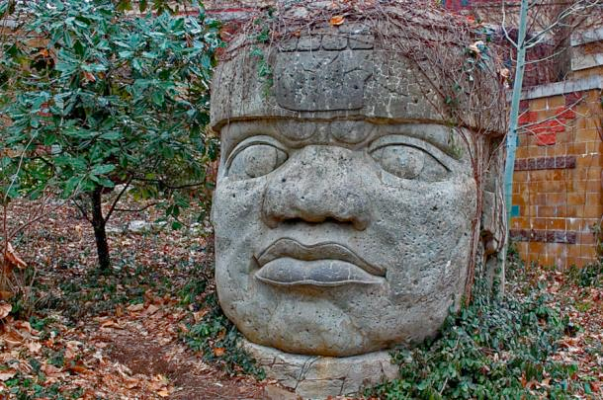
American Civilizations
The Chavin
Located in Peru’s capital of Lima
relied on the Llamas for everything
Tied closely to religion, and when the authority went into decline, so did the civilization
The Olmec
Located in Mesoamerica
Grew Beans, squash, and avocados
Known for basalt monuments of human heads, would drag them with slaves for over 50 miles
Developed a calendar and number system that included 0
Had a system of glyphs, aka pictures of real objects, but this culture did not transmit to later cultures…

Slide 24
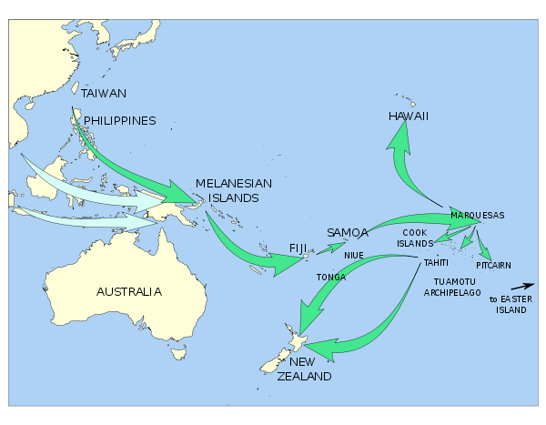
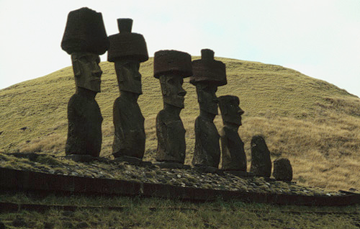
Finally… the pacific peoples
The only people who stayed hunter-gatherers were the Aboriginals in Australia, all other islands had some form of farming

