Slide 1
Chapter 5
Structure: Organization of the Stories

Slide 2
What is structure?
Structure refers to the ways in which writers arrange materials with the general ideas and purposes of their work.
Placement, balance, recurring themes, true and misleading conclusions, suspense, and imitation of the models or forms such as reports, letters, conversations, or confessions.

Slide 3
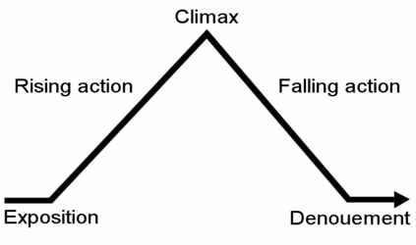
How is it divided?
A work may be divided into numbers sections or parts, or it might begin in one area or state and conclude in another. It may develop a relationship between two people.
Middle adult
Adult
Childhood
Formal Structure

Slide 4
The exposition
Putting forth the information of the story. Tells:
Main characters
Their backgrounds
Their characteristics
Interests
Goals
Limitations
Potentials
Basic assumptions

Slide 5
The complication (Rising action)
The onset and development of major conflict – the plot
Major participants
Protagonist, Antagonist
Their ideals
Good vs. Evil
Freedom or oppression
Independence or dependence
Love or hate
Intelligence or stupidity
Knowledge or ignorance

Slide 6
Crisis marks the end of the conflict
Crisis – Greek work for judgement or separation
Occurs so close to the climax, they are often considered the same.
Greatest point of tension because a decision is to be resolved.

Slide 7
Climax
Climax – Greek word for ladder
Stories high point
Logical conclusion
NO NEW developments follow

Slide 8
Resolution or dénouement
Resolution – Greek for untying or releasing
The completing of the story or play after the climax.
No more tension
Author’s usually end a story quickly as to not lose the readers attention

Slide 9
Actual structure
Welty’s “A Worn Path” is structured in a way that you feel the conflict is about age, poverty and environment until you learn more in the story toward the end.
This story does not have the Formal structure of a story.
Flashbacks can give partial information toward the resolution. This may even bring you to part of the climax but then go from there to develop details that are more properly part of the exposition.

