Slide 1
Read page 282, answer the two questions at the bottom and turn into the tray.
Grab a book off the shelf.

Slide 2
Chapter 9
Industrial Revolution

Slide 3
The Industrial Revolution begins in Britain, spreads to other countries, and has a strong impact on economics, politics, and society.
Industrial Revolution
1700-1900

Slide 4
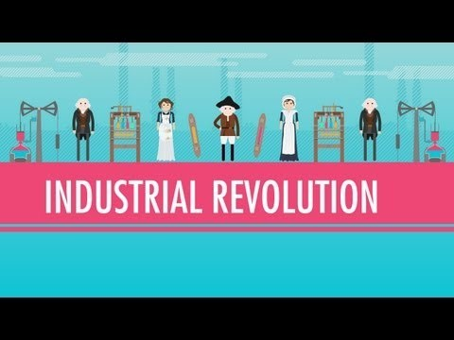

Slide 5
On your notes, draw a timeline.
Fill in the important events in Britain’s Industrial Revolution
1700
1830

Slide 6
Industrial Revolution Begins in Britain
New Ways of Working
•Industrial Revolution—greatly increases output of machine-made goods
•Revolution begins in England in the middle 1700s
The Agricultural Revolution Paves the Way
•Enclosures—large farm fields enclosed by fences or hedges
•Wealthy landowners buy, enclose land once owned by village farmers
•Enclosures allow experimentation with new agricultural methods

Slide 7
Industrial Revolution Begins in Britain
Rotating Crops
•Crop rotation—switching crops each year to avoid depleting the soil
•Livestock breeders allow only the best to breed, improve food supply
Why the Industrial Revolution Began in England
•Industrialization—move to machine production of goods
•Britain has natural resources—coal, iron, rivers, harbors
•Expanding economy in Britain encourages investment
•Britain has all needed factors of production—land, labor, capital (or wealth)

Slide 8
Transformation from farm to factory
Animals
Farmers only breed best animals = more and better meat.
Population
People eating better leads to healthier people = growth in population
Need for work
Food and cloth demand goes up. Enclosed farms lead to lack of work = people go to factories to work.

Slide 10
Inventions Spur Industrialization
Changes in the Textile Industry
•Weavers work faster with flying shuttles and spinning jennies
•Water frame uses water power to drive spinning wheels
•Power loom, spinning mule speed up production, improve quality
•Factories—buildings that contain machinery for manufacturing
•Cotton gin boosts American cotton production to meet British demand

Slide 11
Improvements in Transportation
Watt’s Steam Engine
•Need for cheap, convenient power spurs development of steam engine
•James Watt improves steam engine, financed by Matthew Boulton
•Boulton an entrepreneur—organizes, manages, takes business risks
Water Transportation
•Robert Fulton builds first steamboat, the Clermont, in 1807
•England’s water transport improved by system of canals
Road Transportation
•British roads are improved; companies operate them as toll roads

Slide 12
The Railway Age Begins
The railway age begins in Britain.
Steam-Driven Locomotives
In 1804, Richard Trevithick builds first steam-driven locomotive
In 1825, George Stephenson builds world’s first railroad line
The Liverpool-Manchester Railroad
Entrepreneurs build railroad from Liverpool to Manchester
Stephenson’s Rocket acknowledged as best locomotive (1829)
Railroads Revolutionize Life in Britain
Railroads spur industrial growth, create jobs
Cheaper transportation boosts many industries; people move to cities

Slide 13
On your notes, draw a timeline.
Fill in the important events in Britain’s Industrial Revolution
Water Transportation Invented
Factory improvements
Flying shuttle/spinning jenny
Steam Engine Invented
Agricultural Revolution
Liverpool Manchester
Railroad is invented
1700
1830

Slide 14
Name _____________________________ Class _________________ Date __________________
Section 1, continued
Make notes in the chart to explain how each factor listed contributed to an Industrial Revolution in Great Britain.
1. Agricultural revolution
2. Abundant natural resources
3. Political stability
4. Factors of production
5. Technological advances in the textile industry
6. Entrepreneurs
7. Building of factories
8. Railroad boom

