Slide 1
Unit 3 REview

Slide 2
UNIT 3 Trade Routes
• The Silk Roads
• The Mediterranean Sea
• The Trans-Saharan
• The Indian Ocean basins

Slide 3
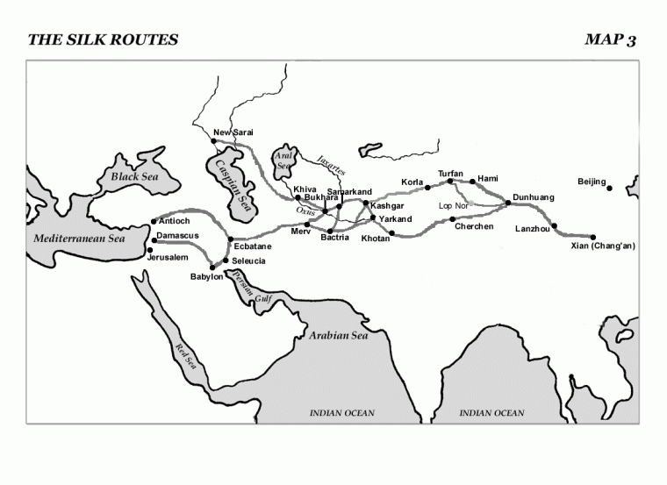

Slide 4
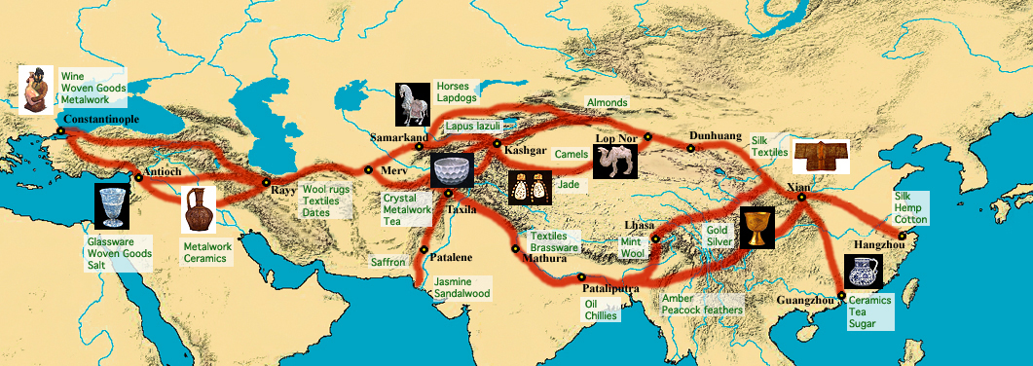
Silk Road

Slide 5
Silk Road Trade 600-1450 C.E.
Silk Road Trade under the Tang and the Mongols was protected.
Mongols kept Silk Road Trade safe.
However, the Mongols were also responsible for carrying the bubonic plague into Eurasia via the Silk Road.

Slide 6
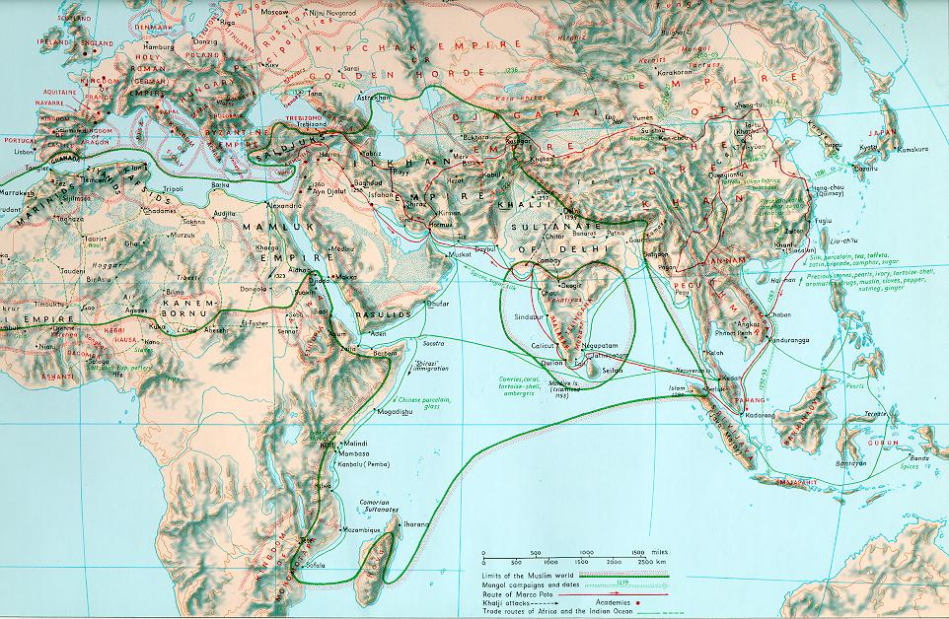
Indian Ocean Trade 600-1450

Slide 7
Indian Ocean Trade 600-1450 C.E.
When Silk Road trade declined with the fall of the Mongols, Indian Ocean trade picked up.
The Ming also renewed focus on Indian Ocean Trade with the voyagers of Zheng He. These voyages were short-lived.
By the 13th century, the Bantu people arrived on the east coast where their language merged with Arabic languages from Muslim traders. This formed the Swahili languages.

Slide 8
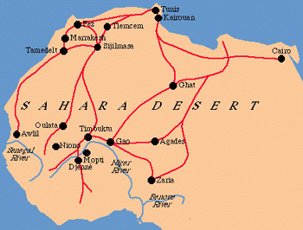
Trans-Saharan Trade 600-1450

Slide 9
Trans-Saharan Trade 600-1450
The Saharan trade extended from the Sub-Saharan West African kingdoms across the Sahara desert to Europe. The Saharan Trade linked such African empires as Ghana, Mali, and Songhay to the European world.
Ghana possessed a large amount of gold.
The Desert regions of present day Morocco and Algeria contained huge salt resources.
The gold-salt trade between the Ghana Empire and the Arab desert merchants flourished.
Notes:
Despite the change in political control of West Africa due to the fall of the Ghana Empire and the rise of the Islamic Mali Empire in 1235, control of the gold-salt trade remained the economic lifeline of the region. Merchants established a second major gold-salt trade route northeast across the Sahara that passed through Tunis, and Cairo, and ended in Egypt's interior. This route complimented the traditional Western Sudan--Maghreb--Europe trade route. As the second trade route grew in popularity, Egypt's influence on the Western Sudan grew as well.
While the kings of the Ghana Empire restricted gold's availablilty during their reigns, the rulers of Mali did not. In fact, Mansa Musa, the most famous ruler of the Mali Empire, spent and gave so much gold during his celebrated hajj (pilgrimage to Mecca) in 1324 that he severely lowered the value of the precious metal in Egypt .

Slide 10
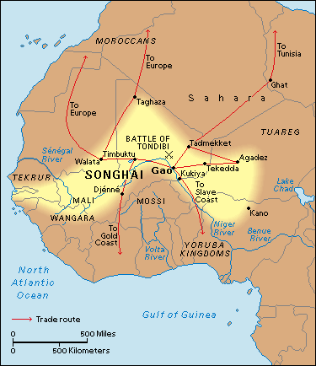
Trans-Saharan Trade 600 C.E. to 1450 C.E.

Slide 11
Trans-Saharan Trade – 600 - 1450
Just as Buddhism reached the Chinese Empire via Indian merchants, Islam reached black West Africa through Arab merchants on caravan routes.
During the Ghana, Mali, and Songhay empires, Arab merchants brought the Koran and the written language Arabic to the oral culture of each empire.
By the 13th century, rulers of western empires had converted to Islam, while common people remained true to their polytheistic beliefs.
Notes:
Merchants transported more than valuable commodities along the trans-Saharan routes. Just as Buddhism reached the Chinese Empire via Indian merchants travelling the Silk Road, Islam reached black West Africa through Arab Merchants on Saharan caravan routes. During the Ghana, Mali, and Songhay empires Arab merchants brought the Koran and the written language Arabic to the traditionally oral cultures each empire encompassed.
Although the common citizens usually felt no pressure to convert from their traditional religions, royal families and merchants often did convert to Islam in order to curry favor with the Arab traders. Kings and merchants understood the importance of extensive trade to their region.

Slide 12
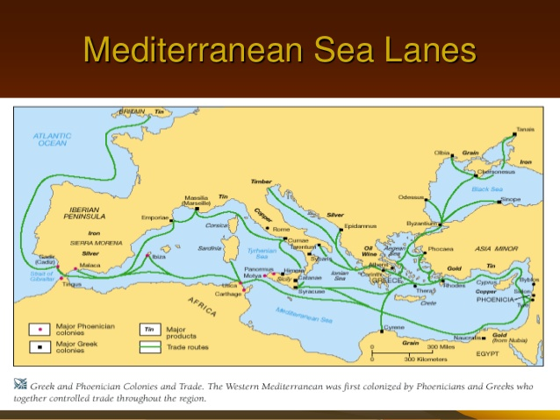

Slide 13
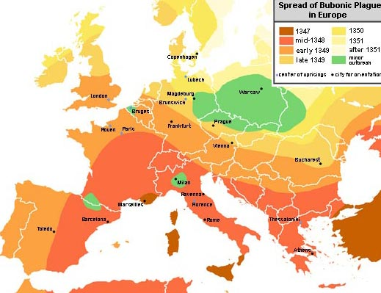
Spread of the Plague

Slide 14
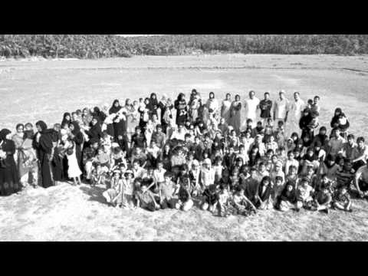
Bantu People

Slide 15
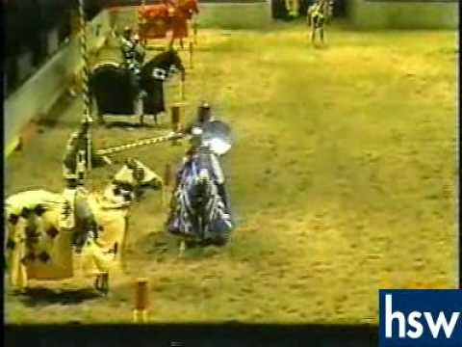
Feudalism

Slide 16
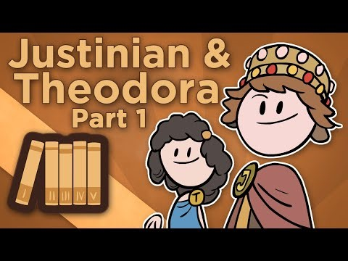
Byzantine Empire

Slide 17
Let’s Try Something
1. As Western Europe folded into themselves and experienced the Middle Ages, which of the following was NOT happening elsewhere?
(A) The Byzantine Empire was flourishing
(B) Indian Ocean Trade with Eastern Africa was strong
(C) Islam was spreading throughout the Middle East
(D) The Spanish had established their first sugar plantation in Cuba

Slide 18
“Moreover, the [severity] of the plague was the greater [because any contact] was apt to [spread] it from the sick to the [healthy], just as fire devours things dry or greasy when they are brought close to it. [T]he evil went yet further, for not merely by speech or association with the sick was the malady [communicated] to the healthy with consequence of common death . . .” -Boccaccio, Decameron
2. Although Boccacio writes this account in Italy in 1347, a similar account could most likely be found from
the Incan civilization
Damascus, Syria
the Mali kingdom
Angor Wat

Slide 19
3. The photograph above of a mosque (first erected in the 14th century) in the modern-day West African country of Mali best exemplifies which of the following historical processes?
(A) Imposition of religion through military conquest
(B) spread of religion along trade routes
(C) abandonment of indigenous cultural styles in the face of colonization
(D) conflict between local and universalizing religions

